Slide 1
Masked RCNN 코드 분석
2021.05.17
작성자 윤경섭 수석

Slide 2
model.py
Norm_boxes_graph
input_gt_masks
MINI_MASK를 사용시
input_gt_masks : shape=(None, 56, 56, None) dtype=bool
Python - callable(), 호출 가능한 object 즉 object가 함수형태로 호출가능한가 여부
h
box
1
box
좌표변환
w
1
resnet_graph
residual net 계층을 만드는 함수
_, C2, C3, C4, C5 = resnet_graph(input_image, config.BACKBONE,
stage5=True, train_bn=config.TRAIN_BN)
residual net 계층을 만드는 것으로 BACKBON에 이름이, state5까지 사용여부, batch normalization freeze 사용 여부이다. C1 ~ C5까지는 각 stage에서의 레이어 값을 볼 수있게 했다.
☞ keras에서 기본적으로 제공되는 resNet을 사용하지 않고 직접 레이어를 만들었는데, 이부분이 어떤 차이가 있는지 확인 해볼 필요가 있다.

Slide 3
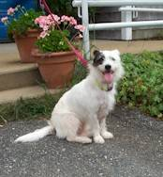
resnet_graph
resnet_graph
residual net 계층을 만드는 함수
x = KL.ZeroPadding2D((3, 3))(input_image)
3 zeros
(None, None, None, 3)
Conv2D 블록 함수 참고
x = KL.Conv2D(64, (7, 7), strides=(2, 2), name='conv1', use_bias=True)(x)
x = BatchNorm(name='bn_conv1')(x, training=train_bn)
x = KL.Activation('relu')(x)
C1 = x = KL.MaxPooling2D((3, 3), strides=(2, 2), padding="same")(x)

Slide 4
model.py
# Size of the top-down layers used to build the feature pyramid
TOP_DOWN_PYRAMID_SIZE = 256
import keras.layers as KL
P5 = KL.Conv2D(config.TOP_DOWN_PYRAMID_SIZE, (1, 1), name='fpn_c5p5')(C5)
P4 = KL.Add(name="fpn_p4add")([
KL.UpSampling2D(size=(2, 2), name="fpn_p5upsampled")(P5),
KL.Conv2D(config.TOP_DOWN_PYRAMID_SIZE, (1, 1), name='fpn_c4p4')(C4)])
P3 = KL.Add(name="fpn_p3add")([
KL.UpSampling2D(size=(2, 2), name="fpn_p4upsampled")(P4),
KL.Conv2D(config.TOP_DOWN_PYRAMID_SIZE, (1, 1), name='fpn_c3p3')(C3)])
P2 = KL.Add(name="fpn_p2add")([
KL.UpSampling2D(size=(2, 2), name="fpn_p3upsampled")(P3),
KL.Conv2D(config.TOP_DOWN_PYRAMID_SIZE, (1, 1), name='fpn_c2p2')(C2)])
# Attach 3x3 conv to all P layers to get the final feature maps.
P2 = KL.Conv2D(config.TOP_DOWN_PYRAMID_SIZE, (3, 3), padding="SAME", name="fpn_p2")(P2)
P3 = KL.Conv2D(config.TOP_DOWN_PYRAMID_SIZE, (3, 3), padding="SAME", name="fpn_p3")(P3)
P4 = KL.Conv2D(config.TOP_DOWN_PYRAMID_SIZE, (3, 3), padding="SAME", name="fpn_p4")(P4)
P5 = KL.Conv2D(config.TOP_DOWN_PYRAMID_SIZE, (3, 3), padding="SAME", name="fpn_p5")(P5)
C1
C2
C3
C4
C5
P5
3x3 Conv
P5
1x1 Conv
2x2 Up
2x2 Up
3x3 Conv
P4
P4
1x1 Conv
P3
2x2 Up
3x3 Conv
P3
1x1 Conv
1x1 Conv
P2
3x3 Conv
P2
P5
max pooling
P6
P6는 RPN에서 사용

Slide 5
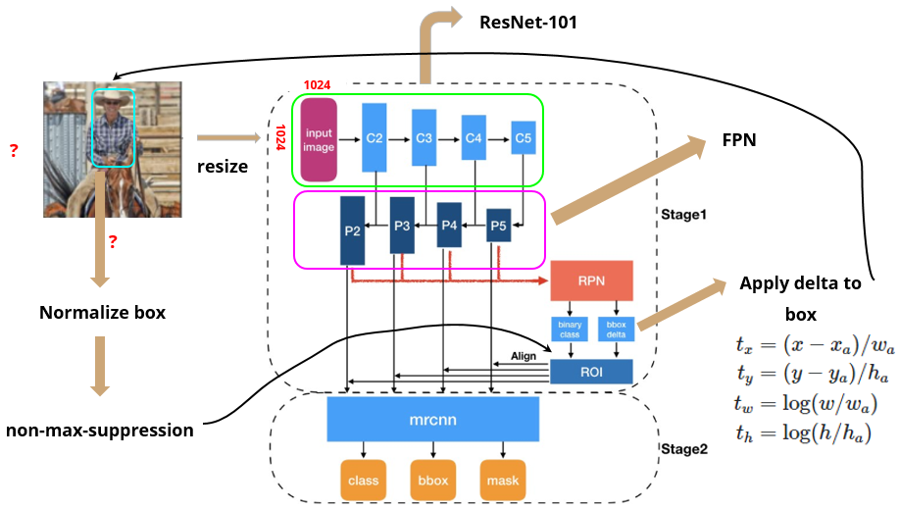
model.py
N x N 사이즈의 인풋 이미지가 주어졌을때 Mask R-CNN의 process는 다음과 같다.

Slide 6
model.py
image_shape
array([1024, 1024, 3])
self.IMAGE_RESIZE_MODE = 'square'
self.IMAGE_SHAPE= array([1024, 1024, 3])
anchors = self.get_anchors(config.IMAGE_SHAPE)
anchors = np.broadcast_to(anchors, (config.BATCH_SIZE,) + anchors.shape)
anchors = AnchorsLayer(anchors, name="anchors")(input_image)
(config.BATCH_SIZE,) + anchors.shape = (1, 261888, 4) →와 같이 텐서 모양을 변환
텐서플로 형으로 변환
self.config.RPN_ANCHOR_RATIOS =[0.5, 1, 2]
rpn = build_rpn_model(config.RPN_ANCHOR_STRIDE = 1,
len(config.RPN_ANCHOR_RATIOS), config.TOP_DOWN_PYRAMID_SIZE)
config.TOP_DOWN_PYRAMID_SIZE = 256
layer_outputs=
rpn[P2]
rpn[P3]
rpn[P4]
rpn[P5]
rpn[P6]
outputs = list(zip(*layer_outputs))

Slide 7
model.py
outputs = list(zip(*layer_outputs))
outputs=
rpn_class_logists[P2,P3,...,P6]
rpn_class[P2,P3,...,P6]
rpn_bbox[P2,P3...,P6]
outputs[0]
outputs[1]
outputs[2]
outputs = [KL.Concatenate(axis=1, name=n)(list(o))
for o, n in zip(outputs, output_names)]
rpn_class_logits = outputs[0] = <KerasTensor: shape=(None, None, 2) dtype=float32 (created by layer 'rpn_class_logits')>
rpn_class = outputs[1] = <KerasTensor: shape=(None, None, 2) dtype=float32 (created by layer 'rpn_class')>
rpn_bbox = outputs[2] = <KerasTensor: shape=(None, None, 4) dtype=float32 (created by layer 'rpn_bbox')>
rpn_class_logits
rpn_class
rpn_bbox
Layout

Slide 8
model.py
rpn_rois = ProposalLayer(
proposal_count=proposal_count=2000,
nms_threshold=config.RPN_NMS_THRESHOLD,
name="ROI",
config=config)([rpn_class, rpn_bbox, anchors])
self.IMAGE_META_SIZE = 1 + 3 + 3 + 4 + 1 + self.NUM_CLASSES
input_image_meta = KL.Input(shape=[config.IMAGE_META_SIZE],
name="input_image_meta")
CLASS_NAMES = ['BG', 'person', 'bicycle', 'car', 'motorcycle', 'airplane', 'bus', 'train', 'truck', 'boat', 'traffic light', 'fire hydrant', 'stop sign', 'parking meter', 'bench', 'bird', 'cat', 'dog', 'horse', 'sheep', 'cow', 'elephant', 'bear', 'zebra', 'giraffe', 'backpack', 'umbrella', 'handbag', 'tie', 'suitcase', 'frisbee', 'skis', 'snowboard', 'sports ball', 'kite', 'baseball bat', 'baseball glove', 'skateboard', 'surfboard', 'tennis racket', 'bottle', 'wine glass', 'cup', 'fork', 'knife', 'spoon', 'bowl', 'banana', 'apple', 'sandwich', 'orange', 'broccoli', 'carrot', 'hot dog', 'pizza', 'donut', 'cake', 'chair', 'couch', 'potted plant', 'bed', 'dining table', 'toilet', 'tv', 'laptop', 'mouse', 'remote', 'keyboard', 'cell phone', 'microwave', 'oven', 'toaster', 'sink', 'refrigerator', 'book', 'clock', 'vase', 'scissors', 'teddy bear', 'hair drier', 'toothbrush']
if mode == "training":
# Class ID mask to mark class IDs supported by the dataset the image
# came from.
active_class_ids = KL.Lambda(
lambda x: parse_image_meta_graph(x)["active_class_ids"]
)(input_image_meta)
if not config.USE_RPN_ROIS:
# Ignore predicted ROIs and use ROIs provided as an input.
input_rois = KL.Input(shape=[config.POST_NMS_ROIS_TRAINING, 4],
name="input_roi", dtype=np.int32)
# Normalize coordinates
target_rois = KL.Lambda(lambda x: norm_boxes_graph(
x, K.shape(input_image)[1:3]))(input_rois)
else:
target_rois = rpn_rois
true
batch 형태의 결과 class dictionary
class의 갯수
TRAIN_BN = False # Defaulting to False since batch size is often small
# Size of the fully-connected layers in the classification graph
FPN_CLASSIF_FC_LAYERS_SIZE = 1024
# Network Heads
# TODO: verify that this handles zero padded ROIs
mrcnn_class_logits, mrcnn_class, mrcnn_bbox =\
fpn_classifier_graph(rois, mrcnn_feature_maps, input_image_meta,
config.POOL_SIZE, config.NUM_CLASSES,
train_bn=config.TRAIN_BN,
fc_layers_size=config.FPN_CLASSIF_FC_LAYERS_SIZE)
mrcnn_feature_maps = [P2, P3, P4, P5]
POOL_SIZE = 7

Slide 9
model.py
mrcnn_mask = build_fpn_mask_graph(rois, mrcnn_feature_maps,
input_image_meta,
config.MASK_POOL_SIZE,
config.NUM_CLASSES,
train_bn=config.TRAIN_BN)
# Losses
rpn_class_loss = KL.Lambda(lambda x: rpn_class_loss_graph(*x), name="rpn_class_loss")(
[input_rpn_match, rpn_class_logits])
rpn_bbox_loss = KL.Lambda(lambda x: rpn_bbox_loss_graph(config, *x), name="rpn_bbox_loss")(
[input_rpn_bbox, input_rpn_match, rpn_bbox])
class_loss = KL.Lambda(lambda x: mrcnn_class_loss_graph(*x), name="mrcnn_class_loss")(
[target_class_ids, mrcnn_class_logits, active_class_ids])
bbox_loss = KL.Lambda(lambda x: mrcnn_bbox_loss_graph(*x), name="mrcnn_bbox_loss")(
[target_bbox, target_class_ids, mrcnn_bbox])
mask_loss = KL.Lambda(lambda x: mrcnn_mask_loss_graph(*x), name="mrcnn_mask_loss")(
[target_mask, target_class_ids, mrcnn_mask])

Slide 10
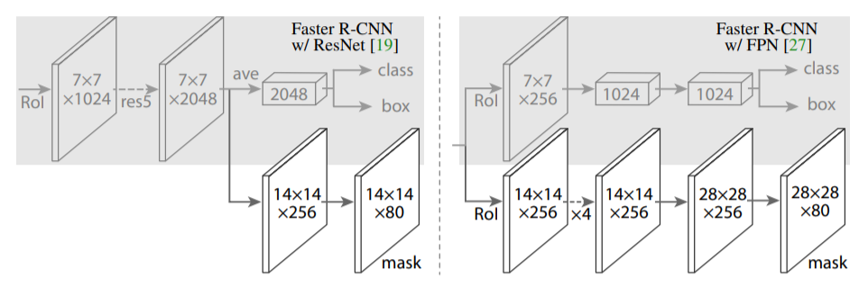
model.py
def build_fpn_mask_graph(rois, feature_maps, image_meta,pool_size, num_classes, train_bn=True):
# Shape: [batch, num_rois, MASK_POOL_SIZE, MASK_POOL_SIZE, channels]
x = PyramidROIAlign([pool_size, pool_size],
name="roi_align_mask")([rois, image_meta] + feature_maps)
fpn_classifier_graph
와 다르게 pool_size가 MASK_POOL_SIZE = 14이다.
# Conv layers
x = KL.TimeDistributed(KL.Conv2D(256, (3, 3), padding="same"),
name="mrcnn_mask_conv1")(x)
x = KL.TimeDistributed(BatchNorm(),
name='mrcnn_mask_bn1')(x, training=train_bn)
x = KL.Activation('relu')(x)
x = KL.TimeDistributed(KL.Conv2D(256, (3, 3), padding="same"),
name="mrcnn_mask_conv2")(x)
x = KL.TimeDistributed(BatchNorm(),
name='mrcnn_mask_bn2')(x, training=train_bn)
x = KL.Activation('relu')(x)
x = KL.TimeDistributed(KL.Conv2D(256, (3, 3), padding="same"),
name="mrcnn_mask_conv3")(x)
x = KL.TimeDistributed(BatchNorm(),
name='mrcnn_mask_bn3')(x, training=train_bn)
x = KL.Activation('relu')(x)
x = KL.TimeDistributed(KL.Conv2D(256, (3, 3), padding="same"),
name="mrcnn_mask_conv4")(x)
x = KL.TimeDistributed(BatchNorm(),
name='mrcnn_mask_bn4')(x, training=train_bn)
x = KL.Activation('relu')(x)
x = KL.TimeDistributed(KL.Conv2DTranspose(256, (2, 2), strides=2, activation="relu"),
name="mrcnn_mask_deconv")(x)
x = KL.TimeDistributed(KL.Conv2D(num_classes, (1, 1), strides=1, activation="sigmoid"),
name="mrcnn_mask")(x)
pool_size=14,num_classes=2
x.shape= ([1, None, 14, 14, 256])
x.shape=([1, None, 28, 28, 256])
x.shape=([1, None, 28, 28, 2])

Slide 11
model.py
def rpn_class_loss_graph(rpn_match, rpn_class_logits):
def rpn_class_loss_graph(rpn_match, rpn_class_logits):
"""RPN anchor classifier loss.
rpn_match: [batch, anchors, 1]. Anchor match type. 1=positive,
-1=negative, 0=neutral anchor.
rpn_class_logits: [batch, anchors, 2]. RPN classifier logits for BG/FG.
"""
# Squeeze last dim to simplify
rpn_match = tf.squeeze(rpn_match, -1)
# Get anchor classes. Convert the -1/+1 match to 0/1 values.
anchor_class = K.cast(K.equal(rpn_match, 1), tf.int32)
# Positive and Negative anchors contribute to the loss,
# but neutral anchors (match value = 0) don't.
indices = tf.where(K.not_equal(rpn_match, 0))
# Pick rows that contribute to the loss and filter out the rest.
rpn_class_logits = tf.gather_nd(rpn_class_logits, indices)
anchor_class = tf.gather_nd(anchor_class, indices)
# Cross entropy loss
loss = K.sparse_categorical_crossentropy(target=anchor_class,
output=rpn_class_logits,
from_logits=True)
loss = K.switch(tf.size(loss) > 0, K.mean(loss), tf.constant(0.0))
return loss

Slide 12
model.py
def get_anchors(self, image_shape):
anchors = self.get_anchors(config.IMAGE_SHAPE)
backbone_shapes = compute_backbone_shapes(self.config, image_shape)
backbone_shape = array([[256, 256], [128, 128], [ 64, 64], [ 32, 32], [ 16, 16]])
영상의 크기의 가로 세로의 크기를 각각 4,8,16,32,64 로 나누어진 것의 어레이를 만든다.
if not hasattr(self, "_anchor_cache"):
self._anchor_cache = {}
# cls에 b라는 멤버가 있는지 확인
>>> hasattr(cls, 'b')
앵커를 만듬.
self.config.RPN_ANCHOR_SCALES = (32, 64, 128, 256, 512)
a = utils.generate_pyramid_anchors(
self.config.RPN_ANCHOR_SCALES,
self.config.RPN_ANCHOR_RATIOS,
backbone_shapes,
self.config.BACKBONE_STRIDES,
self.config.RPN_ANCHOR_STRIDE)
self.config.RPN_ANCHOR_RATIOS =[0.5, 1, 2]
self.config.BACKBONE_STRIDES = [4, 8, 16, 32, 64]
self.config.RPN_ANCHOR_STRIDE = 1
a.shape = (261888, 4)
# TODO: Remove this after the notebook are refactored to not use it
self.anchors = a
# Normalize coordinates
self._anchor_cache[tuple(image_shape)] = utils.norm_boxes(a, image_shape[:2])
self._anchor_cache[(1024,1024,3)].shape = (261888, 4)

Slide 13
model.py
def generate_pyramid_anchors(scales, ratios, feature_shapes, feature_strides, anchor_stride):
anchors = []
for i in range(len(scales)):
anchors.append(generate_anchors(scales[i], ratios, feature_shapes[i],
feature_strides[i], anchor_stride))
return np.concatenate(anchors, axis=0)
[256, 256]
[16, 16]
shape의 크기를 줄이고 격자의 간격을 늘려가는 구조 이다

Slide 14
model.py
scales= (32, 64, 128, 256, 512)
shape =[256,256]
anchor_stride = [1]
def generate_anchors(scales, ratios, shape, feature_stride, anchor_stride):
ratios=[0.5, 1, 2]
feature_stride = [4, 8, 16, 32, 64]
# Get all combinations of scales and ratios
scales, ratios = np.meshgrid(np.array(scales), np.array(ratios))
scales = scales.flatten()
ratios = ratios.flatten()
# Enumerate heights and widths from scales and ratios
heights = scales / np.sqrt(ratios)
widths = scales * np.sqrt(ratios)
# Enumerate shifts in feature space
shifts_y = np.arange(0, shape[0], anchor_stride=1) * feature_stride
shifts_x = np.arange(0, shape[1], anchor_stride=1) * feature_stride
shifts_x, shifts_y = np.meshgrid(shifts_x, shifts_y)
# Enumerate combinations of shifts, widths, and heights
box_widths, box_centers_x = np.meshgrid(widths, shifts_x)
box_heights, box_centers_y = np.meshgrid(heights, shifts_y)
# Reshape to get a list of (y, x) and a list of (h, w)
box_centers = np.stack(
[box_centers_y, box_centers_x], axis=2).reshape([-1, 2])
box_sizes = np.stack([box_heights, box_widths], axis=2).reshape([-1, 2])
# Convert to corner coordinates (y1, x1, y2, x2)
boxes = np.concatenate([box_centers - 0.5 * box_sizes,
box_centers + 0.5 * box_sizes], axis=1)
return boxes
scales = array([[32], [32], [32]])
ratios= array([[0.5], [1. ], [2. ]])
1차원 치환함수
x = np.arange(0,10,1)
x
Out[21]: array([0, 1, 2, 3, 4, 5, 6, 7, 8, 9])
x = np.arange(0,10,1)*2
x
Out[23]: array([ 0, 2, 4, 6, 8, 10, 12, 14, 16, 18])
heights = array([45.254834, 32. , 22.627417])
widths = array([22.627417, 32. , 45.254834])
매번 바뀜
shifts_x = 256*256
array([
[ 0, 4, 8, ..., 1012, 1016, 1020],
[ 0, 4, 8, ..., 1012, 1016, 1020],
[ 0, 4, 8, ..., 1012, 1016, 1020],
...,
[ 0, 4, 8, ..., 1012, 1016, 1020],
[ 0, 4, 8, ..., 1012, 1016, 1020],
[ 0, 4, 8, ..., 1012, 1016, 1020]])
box_widths.shape = (65536, 3)
shifts_y
array([
[ 0, 0, 0, ..., 0, 0, 0],
[ 4, 4, 4, ..., 4, 4, 4],
[ 8, 8, 8, ..., 8, 8, 8],
...,
[1012, 1012, 1012, ..., 1012, 1012, 1012],
[1016, 1016, 1016, ..., 1016, 1016, 1016],
[1020, 1020, 1020, ..., 1020, 1020, 1020]])

Slide 15
model.py
def generate_anchors(scales, ratios, shape, feature_stride, anchor_stride):
box_centers_x
array([
[ 0, 0, 0],
[ 4, 4, 4],
[ 8, 8, 8],
...,
[1012, 1012, 1012],
[1016, 1016, 1016],
[1020, 1020, 1020]])
box_centers
array([
[ 0, 0],
[ 0, 0],
[ 0, 0],
...,
[1020, 1020],
[1020, 1020],
[1020, 1020]])
box_widths
array([
[22.627417, 32. , 45.254834],
[22.627417, 32. , 45.254834],
[22.627417, 32. , 45.254834],
...,
[22.627417, 32. , 45.254834],
[22.627417, 32. , 45.254834],
[22.627417, 32. , 45.254834]])
box_centers_x.shape= (65536, 3)
box_heights
array([
[45.254834, 32. , 22.627417],
[45.254834, 32. , 22.627417],
[45.254834, 32. , 22.627417],
...,
[45.254834, 32. , 22.627417],
[45.254834, 32. , 22.627417],
[45.254834, 32. , 22.627417]])
box_centers_y = 65535*3
array([
[ 0, 0, 0],
[ 0, 0, 0],
[ 0, 0, 0],
...,
[1020, 1020, 1020],
[1020, 1020, 1020],
[1020, 1020, 1020]])
box_sizes
array([
[45.254834, 22.627417],
[32. , 32. ],
[22.627417, 45.254834],
...,
[45.254834, 22.627417],
[32. , 32. ],
[22.627417, 45.254834]])
box_sizes.shape = (196608, 2)
boxes
array([
[ -22.627417 , -11.3137085, 22.627417 , 11.3137085],
[ -16. , -16. , 16. , 16. ],
[ -11.3137085, -22.627417 , 11.3137085, 22.627417 ],
...,
[ 997.372583 , 1008.6862915, 1042.627417 , 1031.3137085],
[1004. , 1004. , 1036. , 1036. ],
[1008.6862915, 997.372583 , 1031.3137085, 1042.627417 ]])
boxes.shape = (196608, 4)
반환 결과 텐서

Slide 16
model.py
rpn = build_rpn_model(config.RPN_ANCHOR_STRIDE = 1,
len(config.RPN_ANCHOR_RATIOS), config.TOP_DOWN_PYRAMID_SIZE)
def build_rpn_model(anchor_stride, anchors_per_location, depth):
input_feature_map = KL.Input(shape=[None, None, depth],
name="input_rpn_feature_map")
outputs = rpn_graph(input_feature_map, anchors_per_location, anchor_stride)
return KM.Model([input_feature_map], outputs, name="rpn_model")
import keras.models as KM

Slide 17
model.py
outputs = rpn_graph(input_feature_map, anchors_per_location, anchor_stride)
def rpn_graph(feature_map, anchors_per_location=3, anchor_stride=1):
shared = KL.Conv2D(512, (3, 3), padding='same', activation='relu',
strides=anchor_stride,
name='rpn_conv_shared')(feature_map)
# Anchor Score. [batch, height, width, anchors per location * 2].
x = KL.Conv2D(2 * anchors_per_location=3, (1, 1), padding='valid',
activation='linear', name='rpn_class_raw')(shared)
# Reshape to [batch, anchors, 2]
rpn_class_logits = KL.Lambda(
lambda t: tf.reshape(t, [tf.shape(t)[0], -1, 2]))(x)
# Softmax on last dimension of BG/FG.
rpn_probs = KL.Activation(
"softmax", name="rpn_class_xxx")(rpn_class_logits)
# Bounding box refinement. [batch, H, W, anchors per location * depth]
# where depth is [x, y, log(w), log(h)]
x = KL.Conv2D(anchors_per_location * 4, (1, 1), padding="valid",
activation='linear', name='rpn_bbox_pred')(shared)
# Reshape to [batch, anchors, 4]
rpn_bbox = KL.Lambda(lambda t: tf.reshape(t, [tf.shape(t)[0], -1, 4]))(x)
return [rpn_class_logits, rpn_probs, rpn_bbox]
feature_map = <KerasTensor: shape=(None, None, None, 256)
shared = <KerasTensor: shape=(None, None, None, 512)
x = <KerasTensor: shape=(None, None, None, 6)
rpn_class_logits = <KerasTensor: shape=(None, None, 2)
class layer
regression layer

Slide 18
model.py
rpn_rois = ProposalLayer(
proposal_count=proposal_count=2000,
nms_threshold=config.RPN_NMS_THRESHOLD,
name="ROI",
config=config)([rpn_class, rpn_bbox, anchors])
class ProposalLayer(KE.Layer):
# Bounding box refinement standard deviation for RPN and final detections.
RPN_BBOX_STD_DEV = np.array([0.1, 0.1, 0.2, 0.2])
scores = inputs[0][:, :, 1]
# Box deltas [batch, num_rois, 4]
deltas = inputs[1]
deltas = deltas * np.reshape(self.config.RPN_BBOX_STD_DEV, [1, 1, 4]) #텐서를 array([[[0.1, 0.1, 0.2, 0.2]]]) 로 바꾼후 deltas와 곱한다.
# Anchors
anchors = inputs[2]
# Improve performance by trimming to top anchors by score
# and doing the rest on the smaller subset.
pre_nms_limit = tf.minimum(self.config.PRE_NMS_LIMIT=6000, tf.shape(anchors)[1])
ix = tf.nn.top_k(scores, pre_nms_limit, sorted=True,
name="top_anchors").indices
scores = utils.batch_slice([scores, ix], lambda x, y: tf.gather(x, y),
self.config.IMAGES_PER_GPU)
deltas = utils.batch_slice([deltas, ix], lambda x, y: tf.gather(x, y),
self.config.IMAGES_PER_GPU)
pre_nms_anchors = utils.batch_slice([anchors, ix], lambda a, x: tf.gather(a, x),
self.config.IMAGES_PER_GPU,
names=["pre_nms_anchors"])
anchor 갯수
1등 부터 순서대로 값이 나옴
foreground의 가장큰 인덱스를 얻음
IMAGES_PER_GPU는 1또는 2
tf.math.top_k는 1차 백터의 가장 큰 값과 인덱스를 알려준다.
result = tf.math.top_k([1, 2, 98, 1, 1, 99, 3, 1, 3, 96, 4, 1], k=3) result.values.numpy() array([99,98,96],dtype=int32) result.indices.numpy() array([5,2,9], dtype=int32)

Slide 19
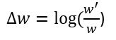
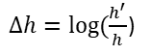
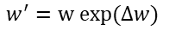
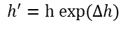
model.py
class ProposalLayer(KE.Layer):
def apply_box_deltas_graph(boxes, deltas):
"""Applies the given deltas to the given boxes.
boxes: [N, (y1, x1, y2, x2)] boxes to update
deltas: [N, (dy, dx, log(dh), log(dw))] refinements to apply
"""
# Convert to y, x, h, w
height = boxes[:, 2] - boxes[:, 0]
width = boxes[:, 3] - boxes[:, 1]
center_y = boxes[:, 0] + 0.5 * height
center_x = boxes[:, 1] + 0.5 * width
# Apply deltas
center_y += deltas[:, 0] * height
center_x += deltas[:, 1] * width
height *= tf.exp(deltas[:, 2])
width *= tf.exp(deltas[:, 3])
# Convert back to y1, x1, y2, x2
y1 = center_y - 0.5 * height
x1 = center_x - 0.5 * width
y2 = y1 + height
x2 = x1 + width
result = tf.stack([y1, x1, y2, x2], axis=1, name="apply_box_deltas_out")
return result
boxes = utils.batch_slice([pre_nms_anchors, deltas],
lambda x, y: apply_box_deltas_graph(x, y),
self.config.IMAGES_PER_GPU,
names=["refined_anchors"])
boxes 값은 델타 값을 적용하여 업데이트 함.
window = np.array([0, 0, 1, 1], dtype=np.float32)
boxes = utils.batch_slice(boxes,
lambda x: clip_boxes_graph(x, window),
self.config.IMAGES_PER_GPU,
names=["refined_anchors_clipped"])
$∆h=log⁡(\frac{h^{′}}{h}$)
$∆w=log⁡(\frac{w^{′}}{w}$)
$$h^{′}=h exp(∆h)$$
$$w^{′}=w exp(∆w)$$
import tensorflow as tf
import numpy as np
def clip_boxes_graph(boxes, window):
"""
boxes: [N, (y1, x1, y2, x2)]
window: [4] in the form y1, x1, y2, x2
"""
# Split
wy1, wx1, wy2, wx2 = tf.split(window, 4)
y1, x1, y2, x2 = tf.split(boxes, 4, axis=1)
# Clip
y1 = tf.maximum(tf.minimum(y1, wy2), wy1)
x1 = tf.maximum(tf.minimum(x1, wx2), wx1)
y2 = tf.maximum(tf.minimum(y2, wy2), wy1)
x2 = tf.maximum(tf.minimum(x2, wx2), wx1)
clipped = tf.concat([y1, x1, y2, x2], axis=1, name="clipped_boxes")
clipped.set_shape((clipped.shape[0], 4))
return clipped
window = np.array([0, 0, 1, 1], dtype=np.float32)
#window = np.array([[0, 0, 1, 1],[0, 0, 1, 1],[0, 0, 1, 1]], dtype=np.float32)
#boxes = np.array([0.1,0.1,0.5,0.5])
boxes = np.array([[0.1,0.1,0.5,0.5],[0.2,0.2,0.6,0.6],[0.3,0.3,0.7,0.7]],dtype=np.float32)
#boxes = np.array([(0.1,0.1,0.5,0.5),(0.2,0.2,0.6,0.6),(0.3,0.3,0.7,0.7)])
boxes = clip_boxes_graph(boxes, window)
print(boxes)
0,0,1,1 박스에서 정규화된 box좌표를 얻는다.
clip_boxes_graph 예제소스
def clip_boxes_graph(boxes, window):
"""
boxes: [N, (y1, x1, y2, x2)]
window: [4] in the form y1, x1, y2, x2
"""
# Split
wy1, wx1, wy2, wx2 = tf.split(window, 4)
y1, x1, y2, x2 = tf.split(boxes, 4, axis=1)
# Clip
y1 = tf.maximum(tf.minimum(y1, wy2), wy1)
x1 = tf.maximum(tf.minimum(x1, wx2), wx1)
y2 = tf.maximum(tf.minimum(y2, wy2), wy1)
x2 = tf.maximum(tf.minimum(x2, wx2), wx1)
clipped = tf.concat([y1, x1, y2, x2], axis=1, name="clipped_boxes")
clipped.set_shape((clipped.shape[0], 4))
return clipped
[0] [0] [1] [1]
window 를 n개의 sub 텐서로 나눈다.

Slide 20
model.py
Non-max supression
1D 인덱스
pad 예제
t = tf.constant([[1, 2, 3], [4, 5, 6]]) paddings = tf.constant([[1, 1,], [2, 2]]) # 'constant_values' is 0. # rank of 't' is 2. tf.pad(t, paddings, "CONSTANT") # [[0, 0, 0, 0, 0, 0, 0], # [0, 0, 1, 2, 3, 0, 0], # [0, 0, 4, 5, 6, 0, 0], # [0, 0, 0, 0, 0, 0, 0]]
# Non-max suppression
def nms(boxes, scores):
indices = tf.image.non_max_suppression(
boxes, scores, self.proposal_count,
self.nms_threshold, name="rpn_non_max_suppression")
proposals = tf.gather(boxes, indices)
# Pad if needed
padding = tf.maximum(self.proposal_count - tf.shape(proposals)[0], 0)
proposals = tf.pad(proposals, [(0, padding), (0, 0)])
return proposals
proposals = utils.batch_slice([boxes, scores], nms,
self.config.IMAGES_PER_GPU)
return proposals
추천 박스들
박스를 조금 크게 만드는 효과?

Slide 21
model.py
Non-max supression
1D 인덱스
pad 예제
t = tf.constant([[1, 2, 3], [4, 5, 6]]) paddings = tf.constant([[1, 1,], [2, 2]]) # 'constant_values' is 0. # rank of 't' is 2. tf.pad(t, paddings, "CONSTANT") # [[0, 0, 0, 0, 0, 0, 0], # [0, 0, 1, 2, 3, 0, 0], # [0, 0, 4, 5, 6, 0, 0], # [0, 0, 0, 0, 0, 0, 0]]
# Non-max suppression
def nms(boxes, scores):
indices = tf.image.non_max_suppression(
boxes, scores, self.proposal_count,
self.nms_threshold, name="rpn_non_max_suppression")
proposals = tf.gather(boxes, indices)
# Pad if needed
padding = tf.maximum(self.proposal_count - tf.shape(proposals)[0], 0)
proposals = tf.pad(proposals, [(0, padding), (0, 0)])
return proposals
proposals = utils.batch_slice([boxes, scores], nms,
self.config.IMAGES_PER_GPU)
return proposals
추천 박스들
박스를 조금 크게 만드는 효과?

Slide 22
model.py
def parse_image_meta_graph(meta):
def parse_image_meta_graph(meta):
"""Parses a tensor that contains image attributes to its components.
See compose_image_meta() for more details.
meta: [batch, meta length] where meta length depends on NUM_CLASSES
Returns a dict of the parsed tensors.
"""
image_id = meta[:, 0]
original_image_shape = meta[:, 1:4]
image_shape = meta[:, 4:7]
window = meta[:, 7:11] # (y1, x1, y2, x2) window of image in in pixels
scale = meta[:, 11]
active_class_ids = meta[:, 12:]
return {
"image_id": image_id,
"original_image_shape": original_image_shape,
"image_shape": image_shape,
"window": window,
"scale": scale,
"active_class_ids": active_class_ids,
}
0 | 1 | 2 | 3 | 4 | 5 | 6 | 7 | 8 | 9 | 10 | 11 | 12
image_id | original_image_shape |  |  | image_shape |  |  | window |  |  |  | scale | active_class_ids
batch
0 | 1 | 2 | 3 | 4 | 5 | 6 | 7 | 8 | 9 | 10 | 11 | 12
image_id | original_image_shape |  |  | image_shape |  |  | window |  |  |  | scale | active_class_ids

Slide 23
utils.py
def batch_slice(inputs, graph_fn, batch_size, names=None):
def batch_slice(inputs, graph_fn, batch_size, names=None):
"""Splits inputs into slices and feeds each slice to a copy of the given
computation graph and then combines the results. It allows you to run a
graph on a batch of inputs even if the graph is written to support one
instance only.
inputs: list of tensors. All must have the same first dimension length
graph_fn: A function that returns a TF tensor that's part of a graph.
batch_size: number of slices to divide the data into.
names: If provided, assigns names to the resulting tensors.
"""
if not isinstance(inputs, list):
inputs = [inputs]
outputs = []
for i in range(batch_size):
inputs_slice = [x[i] for x in inputs]
output_slice = graph_fn(*inputs_slice)
if not isinstance(output_slice, (tuple, list)):
output_slice = [output_slice]
outputs.append(output_slice)
# Change outputs from a list of slices where each is
# a list of outputs to a list of outputs and each has
# a list of slices
outputs = list(zip(*outputs))
if names is None:
names = [None] * len(outputs)
result = [tf.stack(o, axis=0, name=n)
for o, n in zip(outputs, names)]
if len(result) == 1:
result = result[0]
return result
IPdb [3]: names = [None] * 4
IPdb [4]: names
[None, None, None, None]

Slide 24
input_gt_class_ids = KL.Input(
shape=[None], name="input_gt_class_ids", dtype=tf.int32)
utils.py
class DetectionTargetLayer(KE.Layer):
rois, target_class_ids, target_bbox, target_mask =\
DetectionTargetLayer(config, name="proposal_targets")([
target_rois, input_gt_class_ids, gt_boxes, input_gt_masks])
def call(self, inputs):
proposals = inputs[0]
gt_class_ids = inputs[1]
gt_boxes = inputs[2]
gt_masks = inputs[3]
# Slice the batch and run a graph for each slice
# TODO: Rename target_bbox to target_deltas for clarity
names = ["rois", "target_class_ids", "target_bbox", "target_mask"]
outputs = utils.batch_slice(
[proposals, gt_class_ids, gt_boxes, gt_masks],
lambda w, x, y, z: detection_targets_graph(
w, x, y, z, self.config),
self.config.IMAGES_PER_GPU, names=names)
return outputs
gt_boxes: [batch, MAX_GT_INSTANCES, (y1, x1, y2, x2)] in normalized
coordinates.
# [batch, height, width, MAX_GT_INSTANCES]
if config.USE_MINI_MASK:
input_gt_masks = KL.Input(
shape=[config.MINI_MASK_SHAPE[0],
config.MINI_MASK_SHAPE[1], None],
name="input_gt_masks", dtype=bool)
else:
input_gt_masks = KL.Input(
shape=[config.IMAGE_SHAPE[0], config.IMAGE_SHAPE[1], None],
name="input_gt_masks", dtype=bool)
Returns: Target ROIs and corresponding class IDs, bounding box shifts,
and masks.
rois: [TRAIN_ROIS_PER_IMAGE, (y1, x1, y2, x2)] in normalized coordinates
class_ids: [TRAIN_ROIS_PER_IMAGE]. Integer class IDs. Zero padded.
deltas: [TRAIN_ROIS_PER_IMAGE, (dy, dx, log(dh), log(dw))]
masks: [TRAIN_ROIS_PER_IMAGE, height, width]. Masks cropped to bbox
boundaries and resized to neural network output size.
def compute_output_shape(self, input_shape):
return [
(None, self.config.TRAIN_ROIS_PER_IMAGE, 4), # rois
(None, self.config.TRAIN_ROIS_PER_IMAGE), # class_ids
(None, self.config.TRAIN_ROIS_PER_IMAGE, 4), # deltas
(None, self.config.TRAIN_ROIS_PER_IMAGE, self.config.MASK_SHAPE[0],
self.config.MASK_SHAPE[1]) # masks
]
def compute_mask(self, inputs, mask=None):
return [None, None, None, None]

Slide 25
utils.py
def detection_targets_graph(proposals, gt_class_ids, gt_boxes, gt_masks, config):
asserts = [
tf.Assert(tf.greater(tf.shape(proposals)[0], 0), [proposals],
name="roi_assertion"),
]
with tf.control_dependencies(asserts):
proposals = tf.identity(proposals)
# Remove zero padding
proposals, _ = trim_zeros_graph(proposals, name="trim_proposals")
gt_boxes, non_zeros = trim_zeros_graph(gt_boxes, name="trim_gt_boxes")
gt_class_ids = tf.boolean_mask(gt_class_ids, non_zeros,
name="trim_gt_class_ids")
gt_masks = tf.gather(gt_masks, tf.where(non_zeros)[:, 0], axis=2,
name="trim_gt_masks")
# Handle COCO crowds
# A crowd box in COCO is a bounding box around several instances. Exclude
# them from training. A crowd box is given a negative class ID.
# crowd box는 여러 인스턴스가 있는 것으로 음수 값을 갖는다.
crowd_ix = tf.where(gt_class_ids < 0)[:, 0]
non_crowd_ix = tf.where(gt_class_ids > 0)[:, 0]
crowd_boxes = tf.gather(gt_boxes, crowd_ix)
gt_class_ids = tf.gather(gt_class_ids, non_crowd_ix)
gt_boxes = tf.gather(gt_boxes, non_crowd_ix)
gt_masks = tf.gather(gt_masks, non_crowd_ix, axis=2)
# non_crowd box에 대하여 id 와 box mask를 추려낸다.
# Compute overlaps matrix [proposals, gt_boxes]
overlaps = overlaps_graph(proposals, gt_boxes)
# IOU를 계산한다. with crowd boxes [proposals, crowd_boxes]
crowd_overlaps = overlaps_graph(proposals, crowd_boxes)
crowd_iou_max = tf.reduce_max(crowd_overlaps, axis=1)
no_crowd_bool = (crowd_iou_max < 0.001)
# Determine positive and negative ROIs
roi_iou_max = tf.reduce_max(overlaps, axis=1)
# 1. Positive ROIs are those with >= 0.5 IoU with a GT box
positive_roi_bool = (roi_iou_max >= 0.5)
positive_indices = tf.where(positive_roi_bool)[:, 0]
# 2. Negative ROIs are those with < 0.5 with every GT box. Skip crowds.
negative_indices = tf.where(tf.logical_and(roi_iou_max < 0.5, no_crowd_bool))[:, 0]
# Subsample ROIs. Aim for 33% positive
# Positive ROIs
positive_count = int(config.TRAIN_ROIS_PER_IMAGE *
config.ROI_POSITIVE_RATIO)
positive_indices = tf.random.shuffle(positive_indices)[:positive_count]
positive_count = tf.shape(positive_indices)[0]
# Negative ROIs. Add enough to maintain positive:negative ratio.
r = 1.0 / config.ROI_POSITIVE_RATIO
negative_count = tf.cast(r * tf.cast(positive_count, tf.float32), tf.int32) - positive_count
negative_indices = tf.random.shuffle(negative_indices)[:negative_count]
☞ proposal와 gt_boxe와의 IOU를 구한다.
입력과 동일한 크기와 내용의 텐서를 만든다.
0 크기의 박스를 삭제 한다.
non_zeros의 인덱스를 구한다.
☞tf.where에서 컨디션 조건만 있으면, 인덱스를 리턴한다.
☞tf.where(non_zeros)를 하면 [ [1],[3]] 이런식의 열백터가 나오는데, [:, 0]을 추가 함으로 행벡터로 바꾸어준다.
☞ gt_class_ids = tf.boolean_mask(gt_class_ids, non_zeros,
name="trim_gt_class_ids")
gt_class_ids 중 0이 아닌것만 구한다.
☞ positive와 negative 인덱스를 구하고 이에 해당하는 IOU를 구한다.
gt_class_ids: [N] int. Ground truth class IDs

Slide 26
utils.py
def detection_targets_graph(proposals, gt_class_ids, gt_boxes, gt_masks, config):
# Gather selected ROIs
positive_rois = tf.gather(proposals, positive_indices)
negative_rois = tf.gather(proposals, negative_indices)
# Assign positive ROIs to GT boxes.
positive_overlaps = tf.gather(overlaps, positive_indices)
roi_gt_box_assignment = tf.cond(
tf.greater(tf.shape(positive_overlaps)[1], 0),
true_fn = lambda: tf.argmax(positive_overlaps, axis=1),
false_fn = lambda: tf.cast(tf.constant([]),tf.int64)
)
roi_gt_boxes = tf.gather(gt_boxes, roi_gt_box_assignment)
roi_gt_class_ids = tf.gather(gt_class_ids, roi_gt_box_assignment)
# Compute bbox refinement for positive ROIs
deltas = utils.box_refinement_graph(positive_rois, roi_gt_boxes)
deltas /= config.BBOX_STD_DEV
# Assign positive ROIs to GT masks
# Permute masks to [N, height, width, 1]
transposed_masks = tf.expand_dims(tf.transpose(gt_masks, [2, 0, 1]), -1)
# Pick the right mask for each ROI
roi_masks = tf.gather(transposed_masks, roi_gt_box_assignment)
# Compute mask targets
boxes = positive_rois
if config.USE_MINI_MASK:
# Transform ROI coordinates from normalized image space
# to normalized mini-mask space.
y1, x1, y2, x2 = tf.split(positive_rois, 4, axis=1)
gt_y1, gt_x1, gt_y2, gt_x2 = tf.split(roi_gt_boxes, 4, axis=1)
gt_h = gt_y2 - gt_y1
gt_w = gt_x2 - gt_x1
y1 = (y1 - gt_y1) / gt_h
x1 = (x1 - gt_x1) / gt_w
y2 = (y2 - gt_y1) / gt_h
x2 = (x2 - gt_x1) / gt_w
boxes = tf.concat([y1, x1, y2, x2], 1)
box_ids = tf.range(0, tf.shape(roi_masks)[0])
masks = tf.image.crop_and_resize(tf.cast(roi_masks, tf.float32), boxes,
box_ids,
config.MASK_SHAPE)
# Remove the extra dimension from masks.
masks = tf.squeeze(masks, axis=3)
# Threshold mask pixels at 0.5 to have GT masks be 0 or 1 to use with
# binary cross entropy loss.
masks = tf.round(masks)
# Append negative ROIs and pad bbox deltas and masks that
# are not used for negative ROIs with zeros.
rois = tf.concat([positive_rois, negative_rois], axis=0)
N = tf.shape(negative_rois)[0]
P = tf.maximum(config.TRAIN_ROIS_PER_IMAGE - tf.shape(rois)[0], 0)
rois = tf.pad(rois, [(0, P), (0, 0)])
roi_gt_boxes = tf.pad(roi_gt_boxes, [(0, N + P), (0, 0)])
roi_gt_class_ids = tf.pad(roi_gt_class_ids, [(0, N + P)])
deltas = tf.pad(deltas, [(0, N + P), (0, 0)])
masks = tf.pad(masks, [[0, N + P], (0, 0), (0, 0)])
return rois, roi_gt_class_ids, deltas, masks
# max IOU를 갖는 box와 gt_box사이의 차이를 계산하여 리턴한다.
#BBOX_STD_DEV = np.array([0.1, 0.1, 0.2, 0.2])
조건에 근거하여 참이면 참 함수를 아니면 거짓함수를 실행함
tf.cond( pred, true_fn=None, false_fn=None, name=None )
☞ roi_masks에서 boxes에 해당하는 tensor를 리턴한다.

Slide 27
model.py
def fpn_classifier_graph(rois, feature_maps, image_meta, pool_size, num_classes=2, train_bn=True,fc_layers_size=1024):
def fpn_classifier_graph(rois, feature_maps, image_meta,
pool_size, num_classes, train_bn=True,
fc_layers_size=1024):
# ROI Pooling
# Shape: [batch, num_rois, POOL_SIZE, POOL_SIZE, channels]
x = PyramidROIAlign([pool_size, pool_size],
name="roi_align_classifier")([rois, image_meta] + feature_maps)
# Two 1024 FC layers (implemented with Conv2D for consistency)
x = KL.TimeDistributed(KL.Conv2D(fc_layers_size, (pool_size, pool_size), padding="valid"),
name="mrcnn_class_conv1")(x)
x = KL.TimeDistributed(BatchNorm(), name='mrcnn_class_bn1')(x, training=train_bn)
x = KL.Activation('relu')(x)
x = KL.TimeDistributed(KL.Conv2D(fc_layers_size, (1, 1)),
name="mrcnn_class_conv2")(x)
x = KL.TimeDistributed(BatchNorm(), name='mrcnn_class_bn2')(x, training=train_bn)
x = KL.Activation('relu')(x)
#shared = KL.Lambda(lambda x: K.squeeze(K.squeeze(x, 3), 2),
# name="pool_squeeze")(x)
shared = MapLayer(K.squeeze,name="pool_squeeze")(x)
# Classifier head
mrcnn_class_logits = KL.TimeDistributed(KL.Dense(num_classes),
name='mrcnn_class_logits')(shared)
mrcnn_probs = KL.TimeDistributed(KL.Activation("softmax"),
name="mrcnn_class")(mrcnn_class_logits)
# BBox head
# [batch, num_rois, NUM_CLASSES * (dy, dx, log(dh), log(dw))]
x = KL.TimeDistributed(KL.Dense(num_classes * 4, activation='linear'),
name='mrcnn_bbox_fc')(shared)
# Reshape to [batch, num_rois, NUM_CLASSES, (dy, dx, log(dh), log(dw))]
s = K.int_shape(x)
#mrcnn_bbox = KL.Reshape((s[1], num_classes, 4), name="mrcnn_bbox")(x)
if s[1] is None:
mrcnn_bbox = KL.Reshape((-1, num_classes, 4), name="mrcnn_bbox")(x)
else:
mrcnn_bbox = KL.Reshape((s[1], num_classes, 4), name="mrcnn_bbox")(x)
return mrcnn_class_logits, mrcnn_probs, mrcnn_bbox
list로 바뀜
rois =shape=(1, None, 4)
image_meta=shape=(None, 14)
feature_maps = list
x.shape = ([1, None, 7, 7, 256])
x.shape = ([1, None, 1, 1, 1024])
name 결과 | shape
roi_align_classifier | [1, None, 7, 7, 256]
mrcnn_class_conv1 | [1, None, 1, 1, 1024]
mrcnn_class_bn1 | [1, None, 1, 1, 1024]
relu | [1, None, 1, 1, 1024]
mrcnn_class_conv2 | [1, None, 1, 1, 1024]
mrcnn_class_bn2 | [1, None, 1, 1, 1024]
shared | [1,None,1024]
mrcnn_class_logits | ([1, None, 2])
mrcnn_probs | ([1, None, 2])
mrcnn_bbox_fc, s =x | ([1, None, 8])
mrcnn_bbox | (1, None, 2, 4)
class 확율을 구함
2
shape=(1, None, 2)
shape=(1, None, 2)
shape=(1, None, 2, 4)

Slide 28
utils.py
class PyramidROIAlign(KE.Layer):
# Stop gradient propogation to ROI proposals
level_boxes = tf.stop_gradient(level_boxes)
box_indices = tf.stop_gradient(box_indices)
# Crop and Resize
# From Mask R-CNN paper: "We sample four regular locations, so
# that we can evaluate either max or average pooling. In fact,
# interpolating only a single value at each bin center (without
# pooling) is nearly as effective."
#
# Here we use the simplified approach of a single value per bin,
# which is how it's done in tf.crop_and_resize()
# Result: [batch * num_boxes, pool_height, pool_width, channels]
pooled.append(tf.image.crop_and_resize(
feature_maps[i], level_boxes, box_indices, self.pool_shape,
method="bilinear"))
# Pack pooled features into one tensor
pooled = tf.concat(pooled, axis=0)
# Pack box_to_level mapping into one array and add another
# column representing the order of pooled boxes
box_to_level = tf.concat(box_to_level, axis=0)
box_range = tf.expand_dims(tf.range(tf.shape(box_to_level)[0]), 1)
box_to_level = tf.concat([tf.cast(box_to_level, tf.int32), box_range],
axis=1)
# Rearrange pooled features to match the order of the original boxes
# Sort box_to_level by batch then box index
# TF doesn't have a way to sort by two columns, so merge them and sort.
sorting_tensor = box_to_level[:, 0] * 100000 + box_to_level[:, 1]
ix = tf.nn.top_k(sorting_tensor, k=tf.shape(
box_to_level)[0]).indices[::-1]
ix = tf.gather(box_to_level[:, 2], ix)
pooled = tf.gather(pooled, ix)
# Re-add the batch dimension
shape = tf.concat([tf.shape(boxes)[:2], tf.shape(pooled)[1:]], axis=0)
pooled = tf.reshape(pooled, shape)
return pooled
def compute_output_shape(self, input_shape):
return input_shape[0][:2] + self.pool_shape + (input_shape[2][-1], )
class PyramidROIAlign(KE.Layer):
def __init__(self, pool_shape, **kwargs):
super(PyramidROIAlign, self).__init__(**kwargs)
self.pool_shape = tuple(pool_shape)
def call(self, inputs):
# Crop boxes [batch, num_boxes, (y1, x1, y2, x2)] in normalized coords
boxes = inputs[0]
# Image meta
# Holds details about the image. See compose_image_meta()
image_meta = inputs[1]
# Feature Maps. List of feature maps from different level of the
# feature pyramid. Each is [batch, height, width, channels]
feature_maps = inputs[2:]
# Assign each ROI to a level in the pyramid based on the ROI area.
y1, x1, y2, x2 = tf.split(boxes, 4, axis=2)
h = y2 - y1
w = x2 - x1
# Use shape of first image. Images in a batch must have the same size.
image_shape = parse_image_meta_graph(image_meta)['image_shape'][0]
# Equation 1 in the Feature Pyramid Networks paper. Account for
# the fact that our coordinates are normalized here.
# e.g. a 224x224 ROI (in pixels) maps to P4
image_area = tf.cast(image_shape[0] * image_shape[1], tf.float32)
roi_level = log2_graph(tf.sqrt(h * w) / (224.0 / tf.sqrt(image_area)))
roi_level = tf.minimum(5, tf.maximum(
2, 4 + tf.cast(tf.round(roi_level), tf.int32)))
roi_level = tf.squeeze(roi_level, 2)
# Loop through levels and apply ROI pooling to each. P2 to P5.
pooled = []
box_to_level = []
for i, level in enumerate(range(2, 6)):
ix = tf.where(tf.equal(roi_level, level))
level_boxes = tf.gather_nd(boxes, ix)
# Box indices for crop_and_resize.
box_indices = tf.cast(ix[:, 0], tf.int32)
# Keep track of which box is mapped to which level
box_to_level.append(ix)
박스 | 축 ?
box[0]
box[1]
box[2]

Slide 29
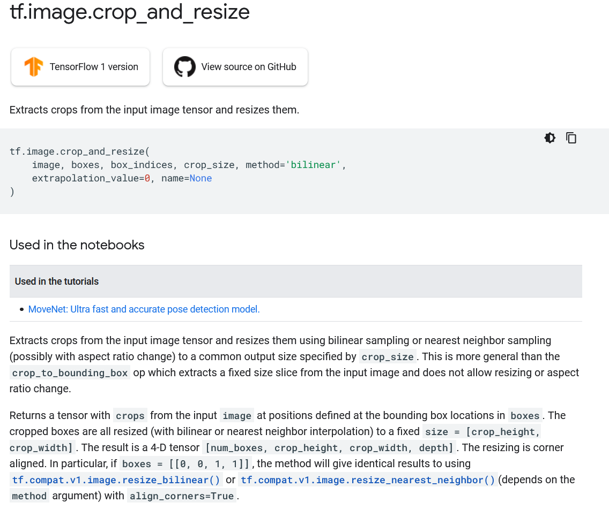
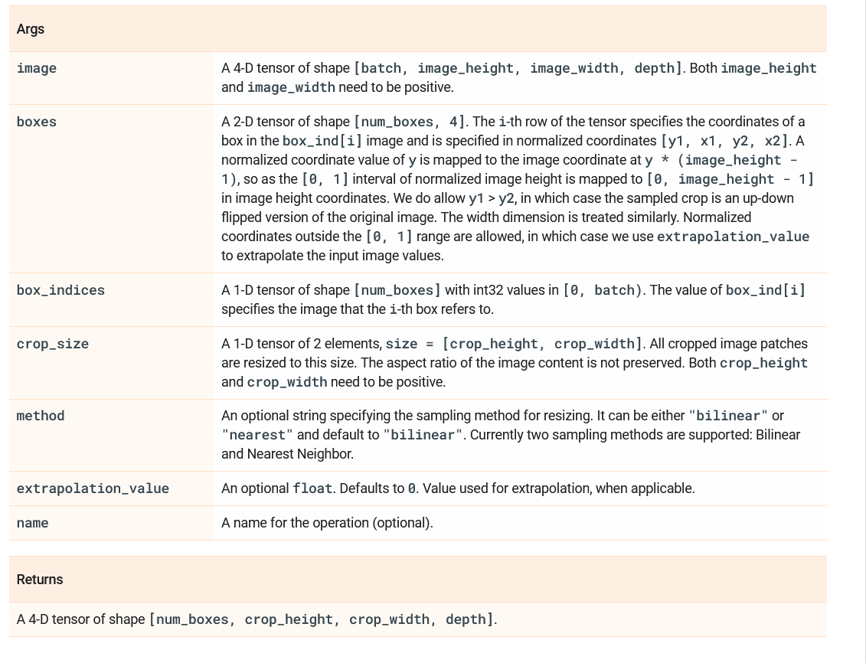
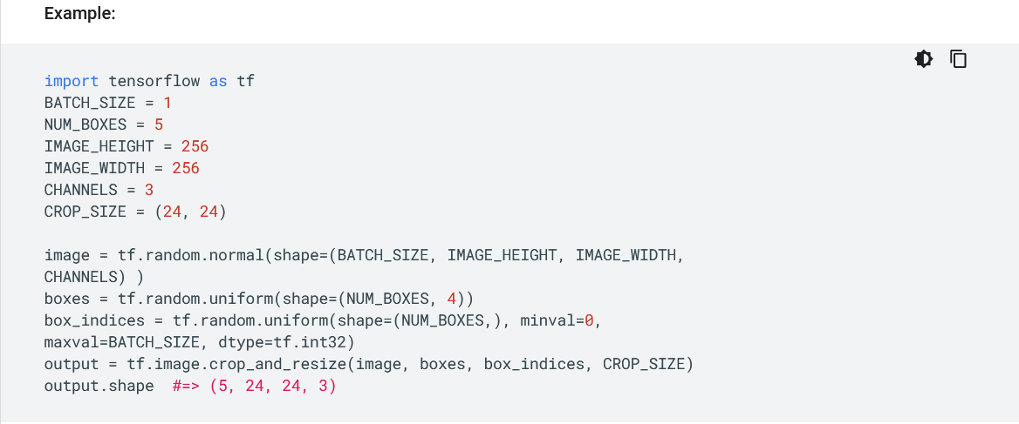
tf.image.crop_and_resize

Slide 30
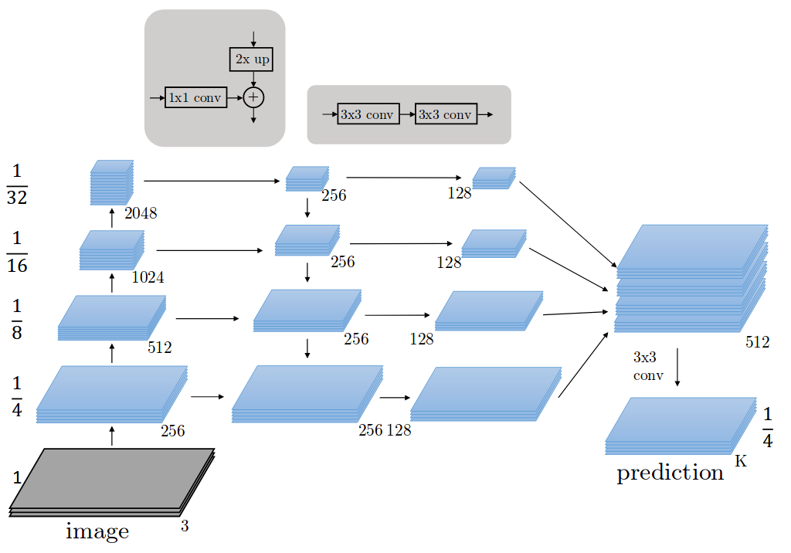
model.py
Feature Pyramid Network

Slide 31
model.py
Feature Pyramid Network

Slide 32
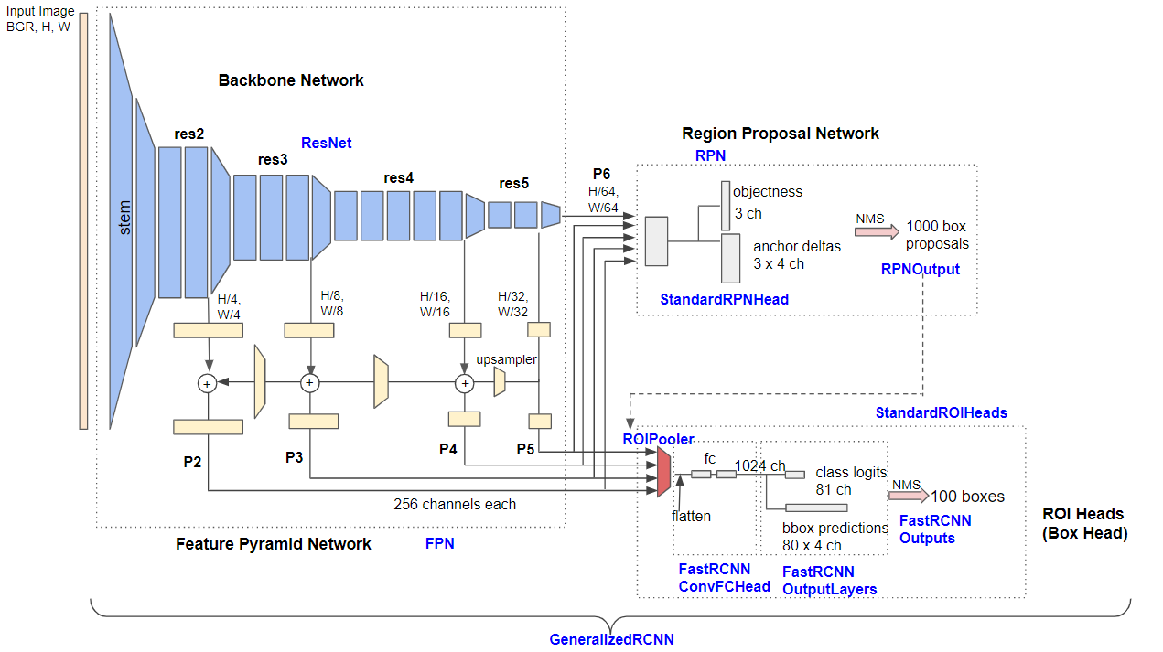
model.py
Training ResNet + Faster R-CNN with FPN

Slide 33
model.py
model summary
__________________________________________________________________________________________________
Layer (type) Output Shape Param # Connected to
==================================================================================================
input_image (InputLayer) [(None, None, None, 0
__________________________________________________________________________________________________
zero_padding2d (ZeroPadding2D) (None, None, None, 3 0 input_image[0][0]
__________________________________________________________________________________________________
conv1 (Conv2D) (None, None, None, 6 9472 zero_padding2d[0][0]
__________________________________________________________________________________________________
bn_conv1 (BatchNorm) (None, None, None, 6 256 conv1[0][0]
__________________________________________________________________________________________________
activation (Activation) (None, None, None, 6 0 bn_conv1[0][0]
__________________________________________________________________________________________________
max_pooling2d (MaxPooling2D) (None, None, None, 6 0 activation[0][0]
__________________________________________________________________________________________________
res2a_branch2a (Conv2D) (None, None, None, 6 4160 max_pooling2d[0][0]
__________________________________________________________________________________________________
bn2a_branch2a (BatchNorm) (None, None, None, 6 256 res2a_branch2a[0][0]
__________________________________________________________________________________________________
activation_1 (Activation) (None, None, None, 6 0 bn2a_branch2a[0][0]
__________________________________________________________________________________________________
res2a_branch2b (Conv2D) (None, None, None, 6 36928 activation_1[0][0]
__________________________________________________________________________________________________
bn2a_branch2b (BatchNorm) (None, None, None, 6 256 res2a_branch2b[0][0]
__________________________________________________________________________________________________
activation_2 (Activation) (None, None, None, 6 0 bn2a_branch2b[0][0]
__________________________________________________________________________________________________
res2a_branch2c (Conv2D) (None, None, None, 2 16640 activation_2[0][0]
__________________________________________________________________________________________________
res2a_branch1 (Conv2D) (None, None, None, 2 16640 max_pooling2d[0][0]
__________________________________________________________________________________________________
bn2a_branch2c (BatchNorm) (None, None, None, 2 1024 res2a_branch2c[0][0]
__________________________________________________________________________________________________
bn2a_branch1 (BatchNorm) (None, None, None, 2 1024 res2a_branch1[0][0]
__________________________________________________________________________________________________
add (Add) (None, None, None, 2 0 bn2a_branch2c[0][0]
bn2a_branch1[0][0]

Slide 34
model.py
__________________________________________________________________________________________________
res2a_out (Activation) (None, None, None, 2 0 add[0][0]
__________________________________________________________________________________________________
res2b_branch2a (Conv2D) (None, None, None, 6 16448 res2a_out[0][0]
__________________________________________________________________________________________________
bn2b_branch2a (BatchNorm) (None, None, None, 6 256 res2b_branch2a[0][0]
__________________________________________________________________________________________________
activation_3 (Activation) (None, None, None, 6 0 bn2b_branch2a[0][0]
__________________________________________________________________________________________________
res2b_branch2b (Conv2D) (None, None, None, 6 36928 activation_3[0][0]
__________________________________________________________________________________________________
bn2b_branch2b (BatchNorm) (None, None, None, 6 256 res2b_branch2b[0][0]
__________________________________________________________________________________________________
activation_4 (Activation) (None, None, None, 6 0 bn2b_branch2b[0][0]
__________________________________________________________________________________________________
res2b_branch2c (Conv2D) (None, None, None, 2 16640 activation_4[0][0]
__________________________________________________________________________________________________
bn2b_branch2c (BatchNorm) (None, None, None, 2 1024 res2b_branch2c[0][0]
__________________________________________________________________________________________________
add_1 (Add) (None, None, None, 2 0 bn2b_branch2c[0][0]
res2a_out[0][0]
__________________________________________________________________________________________________
res2b_out (Activation) (None, None, None, 2 0 add_1[0][0]
__________________________________________________________________________________________________
res2c_branch2a (Conv2D) (None, None, None, 6 16448 res2b_out[0][0]
__________________________________________________________________________________________________
bn2c_branch2a (BatchNorm) (None, None, None, 6 256 res2c_branch2a[0][0]
__________________________________________________________________________________________________
activation_5 (Activation) (None, None, None, 6 0 bn2c_branch2a[0][0]
__________________________________________________________________________________________________
res2c_branch2b (Conv2D) (None, None, None, 6 36928 activation_5[0][0]
__________________________________________________________________________________________________
bn2c_branch2b (BatchNorm) (None, None, None, 6 256 res2c_branch2b[0][0]
__________________________________________________________________________________________________
activation_6 (Activation) (None, None, None, 6 0 bn2c_branch2b[0][0]
__________________________________________________________________________________________________
res2c_branch2c (Conv2D) (None, None, None, 2 16640 activation_6[0][0]
__________________________________________________________________________________________________
bn2c_branch2c (BatchNorm) (None, None, None, 2 1024 res2c_branch2c[0][0]
__________________________________________________________________________________________________
add_2 (Add) (None, None, None, 2 0 bn2c_branch2c[0][0]
res2b_out[0][0]
model summary

Slide 35
model.py
__________________________________________________________________________________________________
res2c_out (Activation) (None, None, None, 2 0 add_2[0][0]
__________________________________________________________________________________________________
res3a_branch2a (Conv2D) (None, None, None, 1 32896 res2c_out[0][0]
__________________________________________________________________________________________________
bn3a_branch2a (BatchNorm) (None, None, None, 1 512 res3a_branch2a[0][0]
__________________________________________________________________________________________________
activation_7 (Activation) (None, None, None, 1 0 bn3a_branch2a[0][0]
__________________________________________________________________________________________________
res3a_branch2b (Conv2D) (None, None, None, 1 147584 activation_7[0][0]
__________________________________________________________________________________________________
bn3a_branch2b (BatchNorm) (None, None, None, 1 512 res3a_branch2b[0][0]
__________________________________________________________________________________________________
activation_8 (Activation) (None, None, None, 1 0 bn3a_branch2b[0][0]
__________________________________________________________________________________________________
res3a_branch2c (Conv2D) (None, None, None, 5 66048 activation_8[0][0]
__________________________________________________________________________________________________
res3a_branch1 (Conv2D) (None, None, None, 5 131584 res2c_out[0][0]
__________________________________________________________________________________________________
bn3a_branch2c (BatchNorm) (None, None, None, 5 2048 res3a_branch2c[0][0]
__________________________________________________________________________________________________
bn3a_branch1 (BatchNorm) (None, None, None, 5 2048 res3a_branch1[0][0]
__________________________________________________________________________________________________
add_3 (Add) (None, None, None, 5 0 bn3a_branch2c[0][0]
bn3a_branch1[0][0]
__________________________________________________________________________________________________
res3a_out (Activation) (None, None, None, 5 0 add_3[0][0]
__________________________________________________________________________________________________
res3b_branch2a (Conv2D) (None, None, None, 1 65664 res3a_out[0][0]
__________________________________________________________________________________________________
bn3b_branch2a (BatchNorm) (None, None, None, 1 512 res3b_branch2a[0][0]
__________________________________________________________________________________________________
activation_9 (Activation) (None, None, None, 1 0 bn3b_branch2a[0][0]
__________________________________________________________________________________________________
res3b_branch2b (Conv2D) (None, None, None, 1 147584 activation_9[0][0]
__________________________________________________________________________________________________
bn3b_branch2b (BatchNorm) (None, None, None, 1 512 res3b_branch2b[0][0]
__________________________________________________________________________________________________
activation_10 (Activation) (None, None, None, 1 0 bn3b_branch2b[0][0]
__________________________________________________________________________________________________
res3b_branch2c (Conv2D) (None, None, None, 5 66048 activation_10[0][0]
__________________________________________________________________________________________________
bn3b_branch2c (BatchNorm) (None, None, None, 5 2048 res3b_branch2c[0][0]
__________________________________________________________________________________________________
add_4 (Add) (None, None, None, 5 0 bn3b_branch2c[0][0]
res3a_out[0][0]
model summary

Slide 36
model.py
__________________________________________________________________________________________________
res3b_out (Activation) (None, None, None, 5 0 add_4[0][0]
__________________________________________________________________________________________________
res3c_branch2a (Conv2D) (None, None, None, 1 65664 res3b_out[0][0]
__________________________________________________________________________________________________
bn3c_branch2a (BatchNorm) (None, None, None, 1 512 res3c_branch2a[0][0]
__________________________________________________________________________________________________
activation_11 (Activation) (None, None, None, 1 0 bn3c_branch2a[0][0]
__________________________________________________________________________________________________
res3c_branch2b (Conv2D) (None, None, None, 1 147584 activation_11[0][0]
__________________________________________________________________________________________________
bn3c_branch2b (BatchNorm) (None, None, None, 1 512 res3c_branch2b[0][0]
__________________________________________________________________________________________________
activation_12 (Activation) (None, None, None, 1 0 bn3c_branch2b[0][0]
__________________________________________________________________________________________________
res3c_branch2c (Conv2D) (None, None, None, 5 66048 activation_12[0][0]
__________________________________________________________________________________________________
bn3c_branch2c (BatchNorm) (None, None, None, 5 2048 res3c_branch2c[0][0]
__________________________________________________________________________________________________
add_5 (Add) (None, None, None, 5 0 bn3c_branch2c[0][0]
res3b_out[0][0]
__________________________________________________________________________________________________
res3c_out (Activation) (None, None, None, 5 0 add_5[0][0]
__________________________________________________________________________________________________
res3d_branch2a (Conv2D) (None, None, None, 1 65664 res3c_out[0][0]
__________________________________________________________________________________________________
bn3d_branch2a (BatchNorm) (None, None, None, 1 512 res3d_branch2a[0][0]
__________________________________________________________________________________________________
activation_13 (Activation) (None, None, None, 1 0 bn3d_branch2a[0][0]
__________________________________________________________________________________________________
res3d_branch2b (Conv2D) (None, None, None, 1 147584 activation_13[0][0]
__________________________________________________________________________________________________
bn3d_branch2b (BatchNorm) (None, None, None, 1 512 res3d_branch2b[0][0]
__________________________________________________________________________________________________
activation_14 (Activation) (None, None, None, 1 0 bn3d_branch2b[0][0]
__________________________________________________________________________________________________
res3d_branch2c (Conv2D) (None, None, None, 5 66048 activation_14[0][0]
__________________________________________________________________________________________________
bn3d_branch2c (BatchNorm) (None, None, None, 5 2048 res3d_branch2c[0][0]
__________________________________________________________________________________________________
add_6 (Add) (None, None, None, 5 0 bn3d_branch2c[0][0]
res3c_out[0][0]
model summary

Slide 37
model.py
model summary
__________________________________________________________________________________________________
res3d_out (Activation) (None, None, None, 5 0 add_6[0][0]
__________________________________________________________________________________________________
res4a_branch2a (Conv2D) (None, None, None, 2 131328 res3d_out[0][0]
__________________________________________________________________________________________________
bn4a_branch2a (BatchNorm) (None, None, None, 2 1024 res4a_branch2a[0][0]
__________________________________________________________________________________________________
activation_15 (Activation) (None, None, None, 2 0 bn4a_branch2a[0][0]
__________________________________________________________________________________________________
res4a_branch2b (Conv2D) (None, None, None, 2 590080 activation_15[0][0]
__________________________________________________________________________________________________
bn4a_branch2b (BatchNorm) (None, None, None, 2 1024 res4a_branch2b[0][0]
__________________________________________________________________________________________________
activation_16 (Activation) (None, None, None, 2 0 bn4a_branch2b[0][0]
__________________________________________________________________________________________________
res4a_branch2c (Conv2D) (None, None, None, 1 263168 activation_16[0][0]
__________________________________________________________________________________________________
res4a_branch1 (Conv2D) (None, None, None, 1 525312 res3d_out[0][0]
__________________________________________________________________________________________________
bn4a_branch2c (BatchNorm) (None, None, None, 1 4096 res4a_branch2c[0][0]
__________________________________________________________________________________________________
bn4a_branch1 (BatchNorm) (None, None, None, 1 4096 res4a_branch1[0][0]
__________________________________________________________________________________________________
add_7 (Add) (None, None, None, 1 0 bn4a_branch2c[0][0]
bn4a_branch1[0][0]
__________________________________________________________________________________________________
res4a_out (Activation) (None, None, None, 1 0 add_7[0][0]
__________________________________________________________________________________________________
res4b_branch2a (Conv2D) (None, None, None, 2 262400 res4a_out[0][0]
__________________________________________________________________________________________________
bn4b_branch2a (BatchNorm) (None, None, None, 2 1024 res4b_branch2a[0][0]
__________________________________________________________________________________________________
activation_17 (Activation) (None, None, None, 2 0 bn4b_branch2a[0][0]
__________________________________________________________________________________________________
res4b_branch2b (Conv2D) (None, None, None, 2 590080 activation_17[0][0]
__________________________________________________________________________________________________
bn4b_branch2b (BatchNorm) (None, None, None, 2 1024 res4b_branch2b[0][0]
__________________________________________________________________________________________________
activation_18 (Activation) (None, None, None, 2 0 bn4b_branch2b[0][0]
__________________________________________________________________________________________________
res4b_branch2c (Conv2D) (None, None, None, 1 263168 activation_18[0][0]
__________________________________________________________________________________________________
bn4b_branch2c (BatchNorm) (None, None, None, 1 4096 res4b_branch2c[0][0]
__________________________________________________________________________________________________
add_8 (Add) (None, None, None, 1 0 bn4b_branch2c[0][0]
res4a_out[0][0]

Slide 38
model.py
__________________________________________________________________________________________________
res4b_out (Activation) (None, None, None, 1 0 add_8[0][0]
__________________________________________________________________________________________________
res4c_branch2a (Conv2D) (None, None, None, 2 262400 res4b_out[0][0]
__________________________________________________________________________________________________
bn4c_branch2a (BatchNorm) (None, None, None, 2 1024 res4c_branch2a[0][0]
__________________________________________________________________________________________________
activation_19 (Activation) (None, None, None, 2 0 bn4c_branch2a[0][0]
__________________________________________________________________________________________________
res4c_branch2b (Conv2D) (None, None, None, 2 590080 activation_19[0][0]
__________________________________________________________________________________________________
bn4c_branch2b (BatchNorm) (None, None, None, 2 1024 res4c_branch2b[0][0]
__________________________________________________________________________________________________
activation_20 (Activation) (None, None, None, 2 0 bn4c_branch2b[0][0]
__________________________________________________________________________________________________
res4c_branch2c (Conv2D) (None, None, None, 1 263168 activation_20[0][0]
__________________________________________________________________________________________________
bn4c_branch2c (BatchNorm) (None, None, None, 1 4096 res4c_branch2c[0][0]
__________________________________________________________________________________________________
add_9 (Add) (None, None, None, 1 0 bn4c_branch2c[0][0]
res4b_out[0][0]
__________________________________________________________________________________________________
res4c_out (Activation) (None, None, None, 1 0 add_9[0][0]
__________________________________________________________________________________________________
res4d_branch2a (Conv2D) (None, None, None, 2 262400 res4c_out[0][0]
__________________________________________________________________________________________________
bn4d_branch2a (BatchNorm) (None, None, None, 2 1024 res4d_branch2a[0][0]
__________________________________________________________________________________________________
activation_21 (Activation) (None, None, None, 2 0 bn4d_branch2a[0][0]
__________________________________________________________________________________________________
res4d_branch2b (Conv2D) (None, None, None, 2 590080 activation_21[0][0]
__________________________________________________________________________________________________
bn4d_branch2b (BatchNorm) (None, None, None, 2 1024 res4d_branch2b[0][0]
__________________________________________________________________________________________________
activation_22 (Activation) (None, None, None, 2 0 bn4d_branch2b[0][0]
__________________________________________________________________________________________________
res4d_branch2c (Conv2D) (None, None, None, 1 263168 activation_22[0][0]
__________________________________________________________________________________________________
bn4d_branch2c (BatchNorm) (None, None, None, 1 4096 res4d_branch2c[0][0]
__________________________________________________________________________________________________
add_10 (Add) (None, None, None, 1 0 bn4d_branch2c[0][0]
res4c_out[0][0]
model summary

Slide 39
model.py
res4d_out (Activation) (None, None, None, 1 0 add_10[0][0]
__________________________________________________________________________________________________
res4e_branch2a (Conv2D) (None, None, None, 2 262400 res4d_out[0][0]
__________________________________________________________________________________________________
bn4e_branch2a (BatchNorm) (None, None, None, 2 1024 res4e_branch2a[0][0]
__________________________________________________________________________________________________
activation_23 (Activation) (None, None, None, 2 0 bn4e_branch2a[0][0]
__________________________________________________________________________________________________
res4e_branch2b (Conv2D) (None, None, None, 2 590080 activation_23[0][0]
__________________________________________________________________________________________________
bn4e_branch2b (BatchNorm) (None, None, None, 2 1024 res4e_branch2b[0][0]
__________________________________________________________________________________________________
activation_24 (Activation) (None, None, None, 2 0 bn4e_branch2b[0][0]
__________________________________________________________________________________________________
res4e_branch2c (Conv2D) (None, None, None, 1 263168 activation_24[0][0]
__________________________________________________________________________________________________
bn4e_branch2c (BatchNorm) (None, None, None, 1 4096 res4e_branch2c[0][0]
__________________________________________________________________________________________________
add_11 (Add) (None, None, None, 1 0 bn4e_branch2c[0][0]
res4d_out[0][0]
__________________________________________________________________________________________________
res4e_out (Activation) (None, None, None, 1 0 add_11[0][0]
__________________________________________________________________________________________________
res4f_branch2a (Conv2D) (None, None, None, 2 262400 res4e_out[0][0]
__________________________________________________________________________________________________
bn4f_branch2a (BatchNorm) (None, None, None, 2 1024 res4f_branch2a[0][0]
__________________________________________________________________________________________________
activation_25 (Activation) (None, None, None, 2 0 bn4f_branch2a[0][0]
__________________________________________________________________________________________________
res4f_branch2b (Conv2D) (None, None, None, 2 590080 activation_25[0][0]
__________________________________________________________________________________________________
bn4f_branch2b (BatchNorm) (None, None, None, 2 1024 res4f_branch2b[0][0]
__________________________________________________________________________________________________
activation_26 (Activation) (None, None, None, 2 0 bn4f_branch2b[0][0]
__________________________________________________________________________________________________
res4f_branch2c (Conv2D) (None, None, None, 1 263168 activation_26[0][0]
__________________________________________________________________________________________________
bn4f_branch2c (BatchNorm) (None, None, None, 1 4096 res4f_branch2c[0][0]
__________________________________________________________________________________________________
add_12 (Add) (None, None, None, 1 0 bn4f_branch2c[0][0]
res4e_out[0][0]
model summary

Slide 40
model.py
__________________________________________________________________________________________________
res4f_out (Activation) (None, None, None, 1 0 add_12[0][0]
__________________________________________________________________________________________________
res4g_branch2a (Conv2D) (None, None, None, 2 262400 res4f_out[0][0]
__________________________________________________________________________________________________
bn4g_branch2a (BatchNorm) (None, None, None, 2 1024 res4g_branch2a[0][0]
__________________________________________________________________________________________________
activation_27 (Activation) (None, None, None, 2 0 bn4g_branch2a[0][0]
__________________________________________________________________________________________________
res4g_branch2b (Conv2D) (None, None, None, 2 590080 activation_27[0][0]
__________________________________________________________________________________________________
bn4g_branch2b (BatchNorm) (None, None, None, 2 1024 res4g_branch2b[0][0]
__________________________________________________________________________________________________
activation_28 (Activation) (None, None, None, 2 0 bn4g_branch2b[0][0]
__________________________________________________________________________________________________
res4g_branch2c (Conv2D) (None, None, None, 1 263168 activation_28[0][0]
__________________________________________________________________________________________________
bn4g_branch2c (BatchNorm) (None, None, None, 1 4096 res4g_branch2c[0][0]
__________________________________________________________________________________________________
add_13 (Add) (None, None, None, 1 0 bn4g_branch2c[0][0]
res4f_out[0][0]
__________________________________________________________________________________________________
res4g_out (Activation) (None, None, None, 1 0 add_13[0][0]
__________________________________________________________________________________________________
res4h_branch2a (Conv2D) (None, None, None, 2 262400 res4g_out[0][0]
__________________________________________________________________________________________________
bn4h_branch2a (BatchNorm) (None, None, None, 2 1024 res4h_branch2a[0][0]
__________________________________________________________________________________________________
activation_29 (Activation) (None, None, None, 2 0 bn4h_branch2a[0][0]
__________________________________________________________________________________________________
res4h_branch2b (Conv2D) (None, None, None, 2 590080 activation_29[0][0]
__________________________________________________________________________________________________
bn4h_branch2b (BatchNorm) (None, None, None, 2 1024 res4h_branch2b[0][0]
__________________________________________________________________________________________________
activation_30 (Activation) (None, None, None, 2 0 bn4h_branch2b[0][0]
__________________________________________________________________________________________________
res4h_branch2c (Conv2D) (None, None, None, 1 263168 activation_30[0][0]
__________________________________________________________________________________________________
bn4h_branch2c (BatchNorm) (None, None, None, 1 4096 res4h_branch2c[0][0]
__________________________________________________________________________________________________
add_14 (Add) (None, None, None, 1 0 bn4h_branch2c[0][0]
res4g_out[0][0]
model summary

Slide 41
model.py
__________________________________________________________________________________________________
res4h_out (Activation) (None, None, None, 1 0 add_14[0][0]
__________________________________________________________________________________________________
res4i_branch2a (Conv2D) (None, None, None, 2 262400 res4h_out[0][0]
__________________________________________________________________________________________________
bn4i_branch2a (BatchNorm) (None, None, None, 2 1024 res4i_branch2a[0][0]
__________________________________________________________________________________________________
activation_31 (Activation) (None, None, None, 2 0 bn4i_branch2a[0][0]
__________________________________________________________________________________________________
res4i_branch2b (Conv2D) (None, None, None, 2 590080 activation_31[0][0]
__________________________________________________________________________________________________
bn4i_branch2b (BatchNorm) (None, None, None, 2 1024 res4i_branch2b[0][0]
__________________________________________________________________________________________________
activation_32 (Activation) (None, None, None, 2 0 bn4i_branch2b[0][0]
__________________________________________________________________________________________________
res4i_branch2c (Conv2D) (None, None, None, 1 263168 activation_32[0][0]
__________________________________________________________________________________________________
bn4i_branch2c (BatchNorm) (None, None, None, 1 4096 res4i_branch2c[0][0]
__________________________________________________________________________________________________
add_15 (Add) (None, None, None, 1 0 bn4i_branch2c[0][0]
res4h_out[0][0]
__________________________________________________________________________________________________
res4i_out (Activation) (None, None, None, 1 0 add_15[0][0]
__________________________________________________________________________________________________
res4j_branch2a (Conv2D) (None, None, None, 2 262400 res4i_out[0][0]
__________________________________________________________________________________________________
bn4j_branch2a (BatchNorm) (None, None, None, 2 1024 res4j_branch2a[0][0]
__________________________________________________________________________________________________
activation_33 (Activation) (None, None, None, 2 0 bn4j_branch2a[0][0]
__________________________________________________________________________________________________
res4j_branch2b (Conv2D) (None, None, None, 2 590080 activation_33[0][0]
__________________________________________________________________________________________________
bn4j_branch2b (BatchNorm) (None, None, None, 2 1024 res4j_branch2b[0][0]
__________________________________________________________________________________________________
activation_34 (Activation) (None, None, None, 2 0 bn4j_branch2b[0][0]
__________________________________________________________________________________________________
res4j_branch2c (Conv2D) (None, None, None, 1 263168 activation_34[0][0]
__________________________________________________________________________________________________
bn4j_branch2c (BatchNorm) (None, None, None, 1 4096 res4j_branch2c[0][0]
__________________________________________________________________________________________________
add_16 (Add) (None, None, None, 1 0 bn4j_branch2c[0][0]
res4i_out[0][0]
model summary

Slide 42
model.py
__________________________________________________________________________________________________
res4j_out (Activation) (None, None, None, 1 0 add_16[0][0]
__________________________________________________________________________________________________
res4k_branch2a (Conv2D) (None, None, None, 2 262400 res4j_out[0][0]
__________________________________________________________________________________________________
bn4k_branch2a (BatchNorm) (None, None, None, 2 1024 res4k_branch2a[0][0]
__________________________________________________________________________________________________
activation_35 (Activation) (None, None, None, 2 0 bn4k_branch2a[0][0]
__________________________________________________________________________________________________
res4k_branch2b (Conv2D) (None, None, None, 2 590080 activation_35[0][0]
__________________________________________________________________________________________________
bn4k_branch2b (BatchNorm) (None, None, None, 2 1024 res4k_branch2b[0][0]
__________________________________________________________________________________________________
activation_36 (Activation) (None, None, None, 2 0 bn4k_branch2b[0][0]
__________________________________________________________________________________________________
res4k_branch2c (Conv2D) (None, None, None, 1 263168 activation_36[0][0]
__________________________________________________________________________________________________
bn4k_branch2c (BatchNorm) (None, None, None, 1 4096 res4k_branch2c[0][0]
__________________________________________________________________________________________________
add_17 (Add) (None, None, None, 1 0 bn4k_branch2c[0][0]
res4j_out[0][0]
__________________________________________________________________________________________________
res4k_out (Activation) (None, None, None, 1 0 add_17[0][0]
__________________________________________________________________________________________________
res4l_branch2a (Conv2D) (None, None, None, 2 262400 res4k_out[0][0]
__________________________________________________________________________________________________
bn4l_branch2a (BatchNorm) (None, None, None, 2 1024 res4l_branch2a[0][0]
__________________________________________________________________________________________________
activation_37 (Activation) (None, None, None, 2 0 bn4l_branch2a[0][0]
__________________________________________________________________________________________________
res4l_branch2b (Conv2D) (None, None, None, 2 590080 activation_37[0][0]
__________________________________________________________________________________________________
bn4l_branch2b (BatchNorm) (None, None, None, 2 1024 res4l_branch2b[0][0]
__________________________________________________________________________________________________
activation_38 (Activation) (None, None, None, 2 0 bn4l_branch2b[0][0]
__________________________________________________________________________________________________
res4l_branch2c (Conv2D) (None, None, None, 1 263168 activation_38[0][0]
__________________________________________________________________________________________________
bn4l_branch2c (BatchNorm) (None, None, None, 1 4096 res4l_branch2c[0][0]
__________________________________________________________________________________________________
add_18 (Add) (None, None, None, 1 0 bn4l_branch2c[0][0]
res4k_out[0][0]
model summary

Slide 43
model.py
__________________________________________________________________________________________________
res4l_out (Activation) (None, None, None, 1 0 add_18[0][0]
__________________________________________________________________________________________________
res4m_branch2a (Conv2D) (None, None, None, 2 262400 res4l_out[0][0]
__________________________________________________________________________________________________
bn4m_branch2a (BatchNorm) (None, None, None, 2 1024 res4m_branch2a[0][0]
__________________________________________________________________________________________________
activation_39 (Activation) (None, None, None, 2 0 bn4m_branch2a[0][0]
__________________________________________________________________________________________________
res4m_branch2b (Conv2D) (None, None, None, 2 590080 activation_39[0][0]
__________________________________________________________________________________________________
bn4m_branch2b (BatchNorm) (None, None, None, 2 1024 res4m_branch2b[0][0]
__________________________________________________________________________________________________
activation_40 (Activation) (None, None, None, 2 0 bn4m_branch2b[0][0]
__________________________________________________________________________________________________
res4m_branch2c (Conv2D) (None, None, None, 1 263168 activation_40[0][0]
__________________________________________________________________________________________________
bn4m_branch2c (BatchNorm) (None, None, None, 1 4096 res4m_branch2c[0][0]
__________________________________________________________________________________________________
add_19 (Add) (None, None, None, 1 0 bn4m_branch2c[0][0]
res4l_out[0][0]
__________________________________________________________________________________________________
res4m_out (Activation) (None, None, None, 1 0 add_19[0][0]
__________________________________________________________________________________________________
res4n_branch2a (Conv2D) (None, None, None, 2 262400 res4m_out[0][0]
__________________________________________________________________________________________________
bn4n_branch2a (BatchNorm) (None, None, None, 2 1024 res4n_branch2a[0][0]
__________________________________________________________________________________________________
activation_41 (Activation) (None, None, None, 2 0 bn4n_branch2a[0][0]
__________________________________________________________________________________________________
res4n_branch2b (Conv2D) (None, None, None, 2 590080 activation_41[0][0]
__________________________________________________________________________________________________
bn4n_branch2b (BatchNorm) (None, None, None, 2 1024 res4n_branch2b[0][0]
__________________________________________________________________________________________________
activation_42 (Activation) (None, None, None, 2 0 bn4n_branch2b[0][0]
__________________________________________________________________________________________________
res4n_branch2c (Conv2D) (None, None, None, 1 263168 activation_42[0][0]
__________________________________________________________________________________________________
bn4n_branch2c (BatchNorm) (None, None, None, 1 4096 res4n_branch2c[0][0]
__________________________________________________________________________________________________
add_20 (Add) (None, None, None, 1 0 bn4n_branch2c[0][0]
res4m_out[0][0]
model summary

Slide 44
model.py
__________________________________________________________________________________________________
res4n_out (Activation) (None, None, None, 1 0 add_20[0][0]
__________________________________________________________________________________________________
res4o_branch2a (Conv2D) (None, None, None, 2 262400 res4n_out[0][0]
__________________________________________________________________________________________________
bn4o_branch2a (BatchNorm) (None, None, None, 2 1024 res4o_branch2a[0][0]
__________________________________________________________________________________________________
activation_43 (Activation) (None, None, None, 2 0 bn4o_branch2a[0][0]
__________________________________________________________________________________________________
res4o_branch2b (Conv2D) (None, None, None, 2 590080 activation_43[0][0]
__________________________________________________________________________________________________
bn4o_branch2b (BatchNorm) (None, None, None, 2 1024 res4o_branch2b[0][0]
__________________________________________________________________________________________________
activation_44 (Activation) (None, None, None, 2 0 bn4o_branch2b[0][0]
__________________________________________________________________________________________________
res4o_branch2c (Conv2D) (None, None, None, 1 263168 activation_44[0][0]
__________________________________________________________________________________________________
bn4o_branch2c (BatchNorm) (None, None, None, 1 4096 res4o_branch2c[0][0]
__________________________________________________________________________________________________
add_21 (Add) (None, None, None, 1 0 bn4o_branch2c[0][0]
res4n_out[0][0]
__________________________________________________________________________________________________
res4o_out (Activation) (None, None, None, 1 0 add_21[0][0]
__________________________________________________________________________________________________
res4p_branch2a (Conv2D) (None, None, None, 2 262400 res4o_out[0][0]
__________________________________________________________________________________________________
bn4p_branch2a (BatchNorm) (None, None, None, 2 1024 res4p_branch2a[0][0]
__________________________________________________________________________________________________
activation_45 (Activation) (None, None, None, 2 0 bn4p_branch2a[0][0]
__________________________________________________________________________________________________
res4p_branch2b (Conv2D) (None, None, None, 2 590080 activation_45[0][0]
__________________________________________________________________________________________________
bn4p_branch2b (BatchNorm) (None, None, None, 2 1024 res4p_branch2b[0][0]
__________________________________________________________________________________________________
activation_46 (Activation) (None, None, None, 2 0 bn4p_branch2b[0][0]
__________________________________________________________________________________________________
res4p_branch2c (Conv2D) (None, None, None, 1 263168 activation_46[0][0]
__________________________________________________________________________________________________
bn4p_branch2c (BatchNorm) (None, None, None, 1 4096 res4p_branch2c[0][0]
__________________________________________________________________________________________________
add_22 (Add) (None, None, None, 1 0 bn4p_branch2c[0][0]
res4o_out[0][0]
model summary

Slide 45
model.py
__________________________________________________________________________________________________
res4p_out (Activation) (None, None, None, 1 0 add_22[0][0]
__________________________________________________________________________________________________
res4q_branch2a (Conv2D) (None, None, None, 2 262400 res4p_out[0][0]
__________________________________________________________________________________________________
bn4q_branch2a (BatchNorm) (None, None, None, 2 1024 res4q_branch2a[0][0]
__________________________________________________________________________________________________
activation_47 (Activation) (None, None, None, 2 0 bn4q_branch2a[0][0]
__________________________________________________________________________________________________
res4q_branch2b (Conv2D) (None, None, None, 2 590080 activation_47[0][0]
__________________________________________________________________________________________________
bn4q_branch2b (BatchNorm) (None, None, None, 2 1024 res4q_branch2b[0][0]
__________________________________________________________________________________________________
activation_48 (Activation) (None, None, None, 2 0 bn4q_branch2b[0][0]
__________________________________________________________________________________________________
res4q_branch2c (Conv2D) (None, None, None, 1 263168 activation_48[0][0]
__________________________________________________________________________________________________
bn4q_branch2c (BatchNorm) (None, None, None, 1 4096 res4q_branch2c[0][0]
__________________________________________________________________________________________________
add_23 (Add) (None, None, None, 1 0 bn4q_branch2c[0][0]
res4p_out[0][0]
__________________________________________________________________________________________________
res4q_out (Activation) (None, None, None, 1 0 add_23[0][0]
__________________________________________________________________________________________________
res4r_branch2a (Conv2D) (None, None, None, 2 262400 res4q_out[0][0]
__________________________________________________________________________________________________
bn4r_branch2a (BatchNorm) (None, None, None, 2 1024 res4r_branch2a[0][0]
__________________________________________________________________________________________________
activation_49 (Activation) (None, None, None, 2 0 bn4r_branch2a[0][0]
__________________________________________________________________________________________________
res4r_branch2b (Conv2D) (None, None, None, 2 590080 activation_49[0][0]
__________________________________________________________________________________________________
bn4r_branch2b (BatchNorm) (None, None, None, 2 1024 res4r_branch2b[0][0]
__________________________________________________________________________________________________
activation_50 (Activation) (None, None, None, 2 0 bn4r_branch2b[0][0]
__________________________________________________________________________________________________
res4r_branch2c (Conv2D) (None, None, None, 1 263168 activation_50[0][0]
__________________________________________________________________________________________________
bn4r_branch2c (BatchNorm) (None, None, None, 1 4096 res4r_branch2c[0][0]
__________________________________________________________________________________________________
add_24 (Add) (None, None, None, 1 0 bn4r_branch2c[0][0]
res4q_out[0][0]
model summary

Slide 46
model.py
__________________________________________________________________________________________________
res4r_out (Activation) (None, None, None, 1 0 add_24[0][0]
__________________________________________________________________________________________________
res4s_branch2a (Conv2D) (None, None, None, 2 262400 res4r_out[0][0]
__________________________________________________________________________________________________
bn4s_branch2a (BatchNorm) (None, None, None, 2 1024 res4s_branch2a[0][0]
__________________________________________________________________________________________________
activation_51 (Activation) (None, None, None, 2 0 bn4s_branch2a[0][0]
__________________________________________________________________________________________________
res4s_branch2b (Conv2D) (None, None, None, 2 590080 activation_51[0][0]
__________________________________________________________________________________________________
bn4s_branch2b (BatchNorm) (None, None, None, 2 1024 res4s_branch2b[0][0]
__________________________________________________________________________________________________
activation_52 (Activation) (None, None, None, 2 0 bn4s_branch2b[0][0]
__________________________________________________________________________________________________
res4s_branch2c (Conv2D) (None, None, None, 1 263168 activation_52[0][0]
__________________________________________________________________________________________________
bn4s_branch2c (BatchNorm) (None, None, None, 1 4096 res4s_branch2c[0][0]
__________________________________________________________________________________________________
add_25 (Add) (None, None, None, 1 0 bn4s_branch2c[0][0]
res4r_out[0][0]
__________________________________________________________________________________________________
res4s_out (Activation) (None, None, None, 1 0 add_25[0][0]
__________________________________________________________________________________________________
res4t_branch2a (Conv2D) (None, None, None, 2 262400 res4s_out[0][0]
__________________________________________________________________________________________________
bn4t_branch2a (BatchNorm) (None, None, None, 2 1024 res4t_branch2a[0][0]
__________________________________________________________________________________________________
activation_53 (Activation) (None, None, None, 2 0 bn4t_branch2a[0][0]
__________________________________________________________________________________________________
res4t_branch2b (Conv2D) (None, None, None, 2 590080 activation_53[0][0]
__________________________________________________________________________________________________
bn4t_branch2b (BatchNorm) (None, None, None, 2 1024 res4t_branch2b[0][0]
__________________________________________________________________________________________________
activation_54 (Activation) (None, None, None, 2 0 bn4t_branch2b[0][0]
__________________________________________________________________________________________________
res4t_branch2c (Conv2D) (None, None, None, 1 263168 activation_54[0][0]
__________________________________________________________________________________________________
bn4t_branch2c (BatchNorm) (None, None, None, 1 4096 res4t_branch2c[0][0]
__________________________________________________________________________________________________
add_26 (Add) (None, None, None, 1 0 bn4t_branch2c[0][0]
res4s_out[0][0]
model summary

Slide 47
model.py
__________________________________________________________________________________________________
res4t_out (Activation) (None, None, None, 1 0 add_26[0][0]
__________________________________________________________________________________________________
res4u_branch2a (Conv2D) (None, None, None, 2 262400 res4t_out[0][0]
__________________________________________________________________________________________________
bn4u_branch2a (BatchNorm) (None, None, None, 2 1024 res4u_branch2a[0][0]
__________________________________________________________________________________________________
activation_55 (Activation) (None, None, None, 2 0 bn4u_branch2a[0][0]
__________________________________________________________________________________________________
res4u_branch2b (Conv2D) (None, None, None, 2 590080 activation_55[0][0]
__________________________________________________________________________________________________
bn4u_branch2b (BatchNorm) (None, None, None, 2 1024 res4u_branch2b[0][0]
__________________________________________________________________________________________________
activation_56 (Activation) (None, None, None, 2 0 bn4u_branch2b[0][0]
__________________________________________________________________________________________________
res4u_branch2c (Conv2D) (None, None, None, 1 263168 activation_56[0][0]
__________________________________________________________________________________________________
bn4u_branch2c (BatchNorm) (None, None, None, 1 4096 res4u_branch2c[0][0]
__________________________________________________________________________________________________
add_27 (Add) (None, None, None, 1 0 bn4u_branch2c[0][0]
res4t_out[0][0]
__________________________________________________________________________________________________
res4u_out (Activation) (None, None, None, 1 0 add_27[0][0]
__________________________________________________________________________________________________
res4v_branch2a (Conv2D) (None, None, None, 2 262400 res4u_out[0][0]
__________________________________________________________________________________________________
bn4v_branch2a (BatchNorm) (None, None, None, 2 1024 res4v_branch2a[0][0]
__________________________________________________________________________________________________
activation_57 (Activation) (None, None, None, 2 0 bn4v_branch2a[0][0]
__________________________________________________________________________________________________
res4v_branch2b (Conv2D) (None, None, None, 2 590080 activation_57[0][0]
__________________________________________________________________________________________________
bn4v_branch2b (BatchNorm) (None, None, None, 2 1024 res4v_branch2b[0][0]
__________________________________________________________________________________________________
activation_58 (Activation) (None, None, None, 2 0 bn4v_branch2b[0][0]
__________________________________________________________________________________________________
res4v_branch2c (Conv2D) (None, None, None, 1 263168 activation_58[0][0]
__________________________________________________________________________________________________
bn4v_branch2c (BatchNorm) (None, None, None, 1 4096 res4v_branch2c[0][0]
__________________________________________________________________________________________________
add_28 (Add) (None, None, None, 1 0 bn4v_branch2c[0][0]
res4u_out[0][0]
model summary

Slide 48
model.py
model summary
__________________________________________________________________________________________________
res4v_out (Activation) (None, None, None, 1 0 add_28[0][0]
__________________________________________________________________________________________________
res4w_branch2a (Conv2D) (None, None, None, 2 262400 res4v_out[0][0]
__________________________________________________________________________________________________
bn4w_branch2a (BatchNorm) (None, None, None, 2 1024 res4w_branch2a[0][0]
__________________________________________________________________________________________________
activation_59 (Activation) (None, None, None, 2 0 bn4w_branch2a[0][0]
__________________________________________________________________________________________________
res4w_branch2b (Conv2D) (None, None, None, 2 590080 activation_59[0][0]
__________________________________________________________________________________________________
bn4w_branch2b (BatchNorm) (None, None, None, 2 1024 res4w_branch2b[0][0]
__________________________________________________________________________________________________
activation_60 (Activation) (None, None, None, 2 0 bn4w_branch2b[0][0]
__________________________________________________________________________________________________
res4w_branch2c (Conv2D) (None, None, None, 1 263168 activation_60[0][0]
__________________________________________________________________________________________________
bn4w_branch2c (BatchNorm) (None, None, None, 1 4096 res4w_branch2c[0][0]
__________________________________________________________________________________________________
add_29 (Add) (None, None, None, 1 0 bn4w_branch2c[0][0]
res4v_out[0][0]
__________________________________________________________________________________________________
res4w_out (Activation) (None, None, None, 1 0 add_29[0][0]
__________________________________________________________________________________________________
res5a_branch2a (Conv2D) (None, None, None, 5 524800 res4w_out[0][0]
__________________________________________________________________________________________________
bn5a_branch2a (BatchNorm) (None, None, None, 5 2048 res5a_branch2a[0][0]
__________________________________________________________________________________________________
activation_61 (Activation) (None, None, None, 5 0 bn5a_branch2a[0][0]
__________________________________________________________________________________________________
res5a_branch2b (Conv2D) (None, None, None, 5 2359808 activation_61[0][0]
__________________________________________________________________________________________________
bn5a_branch2b (BatchNorm) (None, None, None, 5 2048 res5a_branch2b[0][0]
__________________________________________________________________________________________________
activation_62 (Activation) (None, None, None, 5 0 bn5a_branch2b[0][0]
__________________________________________________________________________________________________
res5a_branch2c (Conv2D) (None, None, None, 2 1050624 activation_62[0][0]
__________________________________________________________________________________________________
res5a_branch1 (Conv2D) (None, None, None, 2 2099200 res4w_out[0][0]
__________________________________________________________________________________________________
bn5a_branch2c (BatchNorm) (None, None, None, 2 8192 res5a_branch2c[0][0]
__________________________________________________________________________________________________
bn5a_branch1 (BatchNorm) (None, None, None, 2 8192 res5a_branch1[0][0]
__________________________________________________________________________________________________
add_30 (Add) (None, None, None, 2 0 bn5a_branch2c[0][0]
bn5a_branch1[0][0]

Slide 49
model.py
__________________________________________________________________________________________________
res5a_out (Activation) (None, None, None, 2 0 add_30[0][0]
__________________________________________________________________________________________________
res5b_branch2a (Conv2D) (None, None, None, 5 1049088 res5a_out[0][0]
__________________________________________________________________________________________________
bn5b_branch2a (BatchNorm) (None, None, None, 5 2048 res5b_branch2a[0][0]
__________________________________________________________________________________________________
activation_63 (Activation) (None, None, None, 5 0 bn5b_branch2a[0][0]
__________________________________________________________________________________________________
res5b_branch2b (Conv2D) (None, None, None, 5 2359808 activation_63[0][0]
__________________________________________________________________________________________________
bn5b_branch2b (BatchNorm) (None, None, None, 5 2048 res5b_branch2b[0][0]
__________________________________________________________________________________________________
activation_64 (Activation) (None, None, None, 5 0 bn5b_branch2b[0][0]
__________________________________________________________________________________________________
res5b_branch2c (Conv2D) (None, None, None, 2 1050624 activation_64[0][0]
__________________________________________________________________________________________________
bn5b_branch2c (BatchNorm) (None, None, None, 2 8192 res5b_branch2c[0][0]
__________________________________________________________________________________________________
add_31 (Add) (None, None, None, 2 0 bn5b_branch2c[0][0]
res5a_out[0][0]
__________________________________________________________________________________________________
res5b_out (Activation) (None, None, None, 2 0 add_31[0][0]
__________________________________________________________________________________________________
res5c_branch2a (Conv2D) (None, None, None, 5 1049088 res5b_out[0][0]
__________________________________________________________________________________________________
bn5c_branch2a (BatchNorm) (None, None, None, 5 2048 res5c_branch2a[0][0]
__________________________________________________________________________________________________
activation_65 (Activation) (None, None, None, 5 0 bn5c_branch2a[0][0]
__________________________________________________________________________________________________
res5c_branch2b (Conv2D) (None, None, None, 5 2359808 activation_65[0][0]
__________________________________________________________________________________________________
bn5c_branch2b (BatchNorm) (None, None, None, 5 2048 res5c_branch2b[0][0]
__________________________________________________________________________________________________
activation_66 (Activation) (None, None, None, 5 0 bn5c_branch2b[0][0]
__________________________________________________________________________________________________
res5c_branch2c (Conv2D) (None, None, None, 2 1050624 activation_66[0][0]
__________________________________________________________________________________________________
bn5c_branch2c (BatchNorm) (None, None, None, 2 8192 res5c_branch2c[0][0]
__________________________________________________________________________________________________
add_32 (Add) (None, None, None, 2 0 bn5c_branch2c[0][0]
res5b_out[0][0]
model summary

Slide 50
model.py
model summary
__________________________________________________________________________________________________
res5c_out (Activation) (None, None, None, 2 0 add_32[0][0]
__________________________________________________________________________________________________
fpn_c5p5 (Conv2D) (None, None, None, 2 524544 res5c_out[0][0]
__________________________________________________________________________________________________
fpn_p5upsampled (UpSampling2D) (None, None, None, 2 0 fpn_c5p5[0][0]
__________________________________________________________________________________________________
fpn_c4p4 (Conv2D) (None, None, None, 2 262400 res4w_out[0][0]
__________________________________________________________________________________________________
fpn_p4add (Add) (None, None, None, 2 0 fpn_p5upsampled[0][0]
fpn_c4p4[0][0]
__________________________________________________________________________________________________
fpn_p4upsampled (UpSampling2D) (None, None, None, 2 0 fpn_p4add[0][0]
__________________________________________________________________________________________________
fpn_c3p3 (Conv2D) (None, None, None, 2 131328 res3d_out[0][0]
__________________________________________________________________________________________________
fpn_p3add (Add) (None, None, None, 2 0 fpn_p4upsampled[0][0]
fpn_c3p3[0][0]
__________________________________________________________________________________________________
fpn_p3upsampled (UpSampling2D) (None, None, None, 2 0 fpn_p3add[0][0]
__________________________________________________________________________________________________
fpn_c2p2 (Conv2D) (None, None, None, 2 65792 res2c_out[0][0]
__________________________________________________________________________________________________
fpn_p2add (Add) (None, None, None, 2 0 fpn_p3upsampled[0][0]
fpn_c2p2[0][0]
__________________________________________________________________________________________________
fpn_p5 (Conv2D) (None, None, None, 2 590080 fpn_c5p5[0][0]
__________________________________________________________________________________________________
fpn_p2 (Conv2D) (None, None, None, 2 590080 fpn_p2add[0][0]
__________________________________________________________________________________________________
fpn_p3 (Conv2D) (None, None, None, 2 590080 fpn_p3add[0][0]
__________________________________________________________________________________________________
fpn_p4 (Conv2D) (None, None, None, 2 590080 fpn_p4add[0][0]
__________________________________________________________________________________________________
fpn_p6 (MaxPooling2D) (None, None, None, 2 0 fpn_p5[0][0]

Slide 51
model.py
__________________________________________________________________________________________________
rpn_model (Functional) [(None, None, 2), (N 1189394 fpn_p2[0][0]
fpn_p3[0][0]
fpn_p4[0][0]
fpn_p5[0][0]
fpn_p6[0][0]
__________________________________________________________________________________________________
tf.compat.v1.shape (TFOpLambda) (4,) 0 input_image[0][0]
__________________________________________________________________________________________________
rpn_class (Concatenate) (None, None, 2) 0 rpn_model[0][1]
rpn_model[1][1]
rpn_model[2][1]
rpn_model[3][1]
rpn_model[4][1]
__________________________________________________________________________________________________
rpn_bbox (Concatenate) (None, None, 4) 0 rpn_model[0][2]
rpn_model[1][2]
rpn_model[2][2]
rpn_model[3][2]
rpn_model[4][2]
__________________________________________________________________________________________________
anchors (AnchorsLayer) (1, 261888, 4) 1047552 input_image[0][0]
__________________________________________________________________________________________________
input_gt_boxes (InputLayer) [(None, None, 4)] 0
__________________________________________________________________________________________________
tf.__operators__.getitem (Slici (2,) 0 tf.compat.v1.shape[0][0]
__________________________________________________________________________________________________
ROI (ProposalLayer) (1, None, 4) 0 rpn_class[0][0]
rpn_bbox[0][0]
anchors[0][0]
__________________________________________________________________________________________________
input_gt_class_ids (InputLayer) [(None, None)] 0
__________________________________________________________________________________________________
nboxlayers (NBoxLayer) (None, None, 4) 0 input_gt_boxes[0][0]
tf.__operators__.getitem[0][0]
__________________________________________________________________________________________________
input_gt_masks (InputLayer) [(None, 56, 56, None 0
__________________________________________________________________________________________________
proposal_targets (DetectionTarg [(1, None, 4), (1, N 0 ROI[0][0]
input_gt_class_ids[0][0]
nboxlayers[0][0]
input_gt_masks[0][0]
__________________________________________________________________________________________________
input_image_meta (InputLayer) [(None, 14)] 0
__________________________________________________________________________________________________
roi_align_mask (PyramidROIAlign (1, None, 14, 14, 25 0 proposal_targets[0][0]
input_image_meta[0][0]
fpn_p2[0][0]
fpn_p3[0][0]
fpn_p4[0][0]
fpn_p5[0][0]
model summary

Slide 52
model.py
__________________________________________________________________________________________________
mrcnn_mask_conv1 (TimeDistribut (1, None, 14, 14, 25 590080 roi_align_mask[0][0]
__________________________________________________________________________________________________
mrcnn_mask_bn1 (TimeDistributed (1, None, 14, 14, 25 1024 mrcnn_mask_conv1[0][0]
__________________________________________________________________________________________________
activation_70 (Activation) (1, None, 14, 14, 25 0 mrcnn_mask_bn1[0][0]
__________________________________________________________________________________________________
mrcnn_mask_conv2 (TimeDistribut (1, None, 14, 14, 25 590080 activation_70[0][0]
__________________________________________________________________________________________________
roi_align_classifier (PyramidRO (1, None, 7, 7, 256) 0 proposal_targets[0][0]
input_image_meta[0][0]
fpn_p2[0][0]
fpn_p3[0][0]
fpn_p4[0][0]
fpn_p5[0][0]
__________________________________________________________________________________________________
mrcnn_mask_bn2 (TimeDistributed (1, None, 14, 14, 25 1024 mrcnn_mask_conv2[0][0]
__________________________________________________________________________________________________
mrcnn_class_conv1 (TimeDistribu (1, None, 1, 1, 1024 12846080 roi_align_classifier[0][0]
__________________________________________________________________________________________________
activation_71 (Activation) (1, None, 14, 14, 25 0 mrcnn_mask_bn2[0][0]
__________________________________________________________________________________________________
mrcnn_class_bn1 (TimeDistribute (1, None, 1, 1, 1024 4096 mrcnn_class_conv1[0][0]
__________________________________________________________________________________________________
mrcnn_mask_conv3 (TimeDistribut (1, None, 14, 14, 25 590080 activation_71[0][0]
__________________________________________________________________________________________________
activation_67 (Activation) (1, None, 1, 1, 1024 0 mrcnn_class_bn1[0][0]
__________________________________________________________________________________________________
mrcnn_mask_bn3 (TimeDistributed (1, None, 14, 14, 25 1024 mrcnn_mask_conv3[0][0]
__________________________________________________________________________________________________
mrcnn_class_conv2 (TimeDistribu (1, None, 1, 1, 1024 1049600 activation_67[0][0]
__________________________________________________________________________________________________
activation_72 (Activation) (1, None, 14, 14, 25 0 mrcnn_mask_bn3[0][0]
__________________________________________________________________________________________________
mrcnn_class_bn2 (TimeDistribute (1, None, 1, 1, 1024 4096 mrcnn_class_conv2[0][0]
__________________________________________________________________________________________________
mrcnn_mask_conv4 (TimeDistribut (1, None, 14, 14, 25 590080 activation_72[0][0]
__________________________________________________________________________________________________
activation_68 (Activation) (1, None, 1, 1, 1024 0 mrcnn_class_bn2[0][0]
__________________________________________________________________________________________________
mrcnn_mask_bn4 (TimeDistributed (1, None, 14, 14, 25 1024 mrcnn_mask_conv4[0][0]
__________________________________________________________________________________________________
pool_squeeze (MapLayer) (1, None, 1024) 0 activation_68[0][0]
__________________________________________________________________________________________________
activation_73 (Activation) (1, None, 14, 14, 25 0 mrcnn_mask_bn4[0][0]
__________________________________________________________________________________________________
mrcnn_bbox_fc (TimeDistributed) (1, None, 8) 8200 pool_squeeze[0][0]
__________________________________________________________________________________________________
mrcnn_mask_deconv (TimeDistribu (1, None, 28, 28, 25 262400 activation_73[0][0]
model summary

Slide 53
model.py
model summary
rpn_class_logits (Concatenate) (None, None, 2) 0 rpn_model[0][0]
rpn_model[1][0]
rpn_model[2][0]
rpn_model[3][0]
rpn_model[4][0]
__________________________________________________________________________________________________
mrcnn_class_logits (TimeDistrib (1, None, 2) 2050 pool_squeeze[0][0]
__________________________________________________________________________________________________
mrcnn_bbox (Reshape) (1, None, 2, 4) 0 mrcnn_bbox_fc[0][0]
__________________________________________________________________________________________________
mrcnn_mask (TimeDistributed) (1, None, 28, 28, 2) 514 mrcnn_mask_deconv[0][0]
__________________________________________________________________________________________________
input_rpn_match (InputLayer) [(None, None, 1)] 0
__________________________________________________________________________________________________
input_rpn_bbox (InputLayer) [(None, None, 4)] 0
__________________________________________________________________________________________________
lambda_2 (Lambda) (None, 2) 0 input_image_meta[0][0]
__________________________________________________________________________________________________
mrcnn_class (TimeDistributed) (1, None, 2) 0 mrcnn_class_logits[0][0]
__________________________________________________________________________________________________
output_rois (Lambda) (1, None, 4) 0 proposal_targets[0][0]
__________________________________________________________________________________________________
rpn_class_loss (Lambda) () 0 input_rpn_match[0][0]
rpn_class_logits[0][0]
__________________________________________________________________________________________________
rpn_bbox_loss (Lambda) () 0 input_rpn_bbox[0][0]
input_rpn_match[0][0]
rpn_bbox[0][0]
__________________________________________________________________________________________________
mrcnn_class_loss (Lambda) () 0 proposal_targets[0][1]
mrcnn_class_logits[0][0]
lambda_2[0][0]
__________________________________________________________________________________________________
mrcnn_bbox_loss (Lambda) () 0 proposal_targets[0][2]
proposal_targets[0][1]
mrcnn_bbox[0][0]
__________________________________________________________________________________________________
mrcnn_mask_loss (Lambda) () 0 proposal_targets[0][3]
proposal_targets[0][1]
mrcnn_mask[0][0]
==================================================================================================
Total params: 64,780,958
Trainable params: 64,669,470
Non-trainable params: 111,488
__________________________________________________________________________________________________

Slide 54
resnet_graph
resnet_graph
x = conv_block(x, 3, [64, 64, 256], stage=2, block='a', strides=(1, 1), train_bn=train_bn)
x = identity_block(x, 3, [64, 64, 256], stage=2, block='b', train_bn=train_bn)
C2 = x = identity_block(x, 3, [64, 64, 256], stage=2, block='c', train_bn=train_bn)
x = conv_block(x, 3, [128, 128, 512], stage=3, block='a', train_bn=train_bn)
x = identity_block(x, 3, [128, 128, 512], stage=3, block='b', train_bn=train_bn)
x = identity_block(x, 3, [128, 128, 512], stage=3, block='c', train_bn=train_bn)
C3 = x = identity_block(x, 3, [128, 128, 512], stage=3, block='d', train_bn=train_bn)
if stage5:
x = conv_block(x, 3, [512, 512, 2048], stage=5, block='a', train_bn=train_bn)
x = identity_block(x, 3, [512, 512, 2048], stage=5, block='b', train_bn=train_bn)
C5 = x = identity_block(x, 3, [512, 512, 2048], stage=5, block='c', train_bn=train_bn)
else:
C5 = None
return [C1, C2, C3, C4, C5]

Slide 55
conv_block 함수
conv_block
def conv_block(input_tensor, kernel_size, filters, stage, block,
strides=(2, 2), use_bias=True, train_bn=True)
256
128
shortcut
64
2개의 결과를 합치는 구조
x.shape
TensorShape([None, None, None, 256])
256

Slide 56
identity_block 함수
identity_block
x = identity_block(x, 3, [64, 64, 256], stage=2, block='b', train_bn=train_bn)
def identity_block(input_tensor, kernel_size, filters, stage, block,
use_bias=True, train_bn=True):
1x1
3x3
1x1
256
64
64
x.shape
TensorShape([None, None, None, 256])

Slide 57
Python 기본
Callable
callable() : 호출 가능한 object 즉 object가 함수형태로 호출가능한가 여부
ZeroPadding2D
케라스의 ZeroPadding2D 레이어는 padding 인자 값을 int / tuple of 2ints / tuple of 2 tuples of 2 ints의 3가지 케이스로 받을 수 있다.
- padding=2로 주는 것은 width와 height의 크기를 2씩 늘린다. 100x100 -> 104x104가 됨
- padding=(2, 2)로 주는 것은 위의 케이스와 같다. 그렇지만 height, width에 주는 padding값을 다르게 지정해줄 수 있다.
- padding=((0,1), (0,1))과 같이 2개의 int를 가지고 있는 튜플을 2개 사용한다. ((top_pad, bottom_pad), (left_pad, right_pad))이기 때문에 내가 원하는 위치에만 패딩 값을 줄 수 있다.
numpy.broadcast_to(array, shape, subok=False)
배열을 새로운 모양으로 브로드 캐스트합니다.
Parameters
arrayarray_like
브로드 캐스트 할 배열입니다.
shapetuple
원하는 배열의 모양입니다.
subokbool, optional
True 인 경우 하위 클래스가 전달되고, 그렇지 않으면 반환 된 배열은 기본 클래스 배열이됩니다 (기본값).
Returns
broadcastarray
alist = [[1,2,3], [4,5,6], [7,8,9]]
for i in zip(alist):
print(i)
([1, 2, 3],)
([4, 5, 6],)
([7, 8, 9],)
for i in zip(*alist):
print(i)
(1, 4, 7)
(2, 5, 8)
(3, 6, 9)

Slide 58
Python 기본
Zip 함수
alist = [[1,2,3], [4,5,6], [7,8,9]]
for i in zip(alist):
print(i)
([1, 2, 3],)
([4, 5, 6],)
([7, 8, 9],)
for i in zip(*alist): col 끼리 묶어 줌
print(i)
(1, 4, 7)
(2, 5, 8)
(3, 6, 9)

Slide 59
Python 기본
bach_slice 함수
import numpy as np
import tensorflow as tf
def batch_slice(inputs, graph_fn, batch_size, names=None):
"""Splits inputs into slices and feeds each slice to a copy of the given
computation graph and then combines the results. It allows you to run a
graph on a batch of inputs even if the graph is written to support one
instance only.
inputs: list of tensors. All must have the same first dimension length
graph_fn: A function that returns a TF tensor that's part of a graph.
batch_size: number of slices to divide the data into.
names: If provided, assigns names to the resulting tensors.
"""
if not isinstance(inputs, list):
inputs = [inputs]
outputs = []
for i in range(batch_size):
inputs_slice = [x[i] for x in inputs]
output_slice = graph_fn(*inputs_slice)
if not isinstance(output_slice, (tuple, list)):
output_slice = [output_slice]
outputs.append(output_slice)
# Change outputs from a list of slices where each is
# a list of outputs to a list of outputs and each has
# a list of slices
outputs = list(zip(*outputs))
if names is None:
names = [None] * len(outputs)
result = [tf.stack(o, axis=0, name=n)
for o, n in zip(outputs, names)]
if len(result) == 1:
result = result[0]
return result
#scores = tf.constant([1, 2, 98, 1, 1, 99, 3, 1, 3, 96, 4, 1], dtype = tf.float64)
scores = tf.constant([[1, 2,3,4],[5,6,7,8]])
ix = tf.math.top_k(scores,k=3,sorted=True,name="top_anchors").indices
result = batch_slice([scores,ix],lambda x, y: tf.gather(x, y),2)
print(result[0].eval)
print(result[1].eval)
<bound method _EagerTensorBase.eval of <tf.Tensor: shape=(3,), dtype=int32, numpy=array([4, 3, 2])>>
<bound method _EagerTensorBase.eval of <tf.Tensor: shape=(3,), dtype=int32, numpy=array([8, 7, 6])>>
입력텐서가 주어질 때 가장 큰 값을 기준으로
순서 대로 뽑아 주는 함수이다.
만일 입력이 1차원이면
inputs_slice = [x for x in inputs]
수정 하여야 한다.

Slide 60
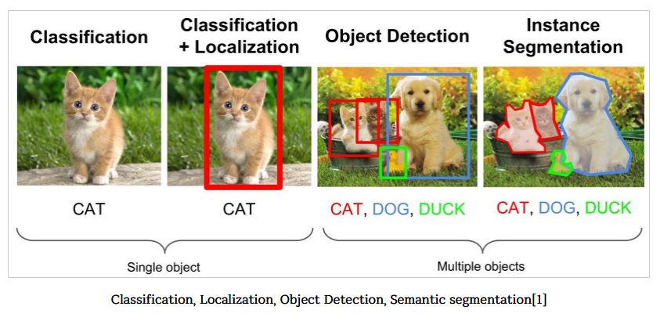
Deep learning 영상인식 분야

Slide 61
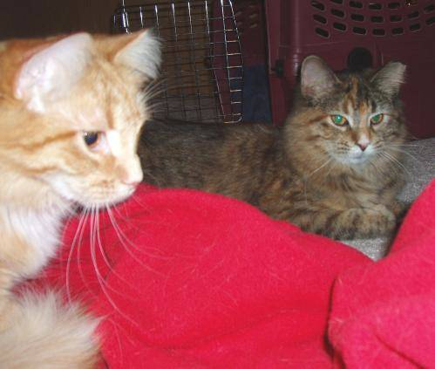
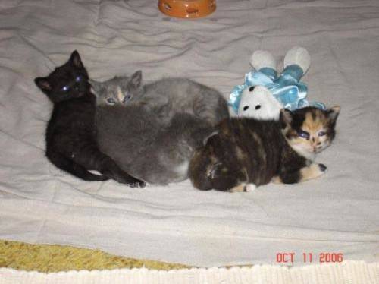
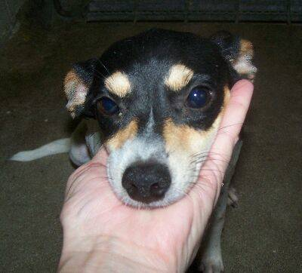
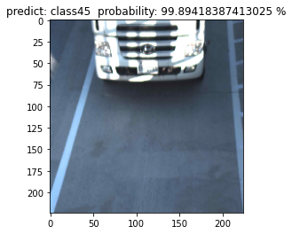
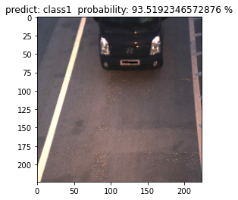
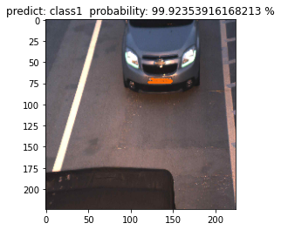
기반 기술
개/고양이 binary label classification 소스 참고
Multi label classification 변형

Slide 62
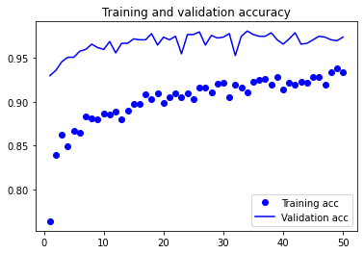
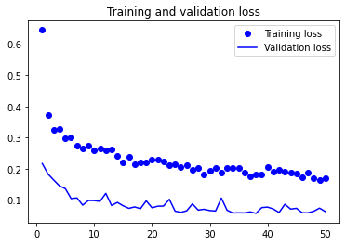
시험 방법 cont
1차 시험
서대구 영업소 다차로 21041장
Train 4000(소형 2000, 대형 2000)
Validation 1000(소형 500, 대형 500)
Test 1000(소형 500, 대형 500)
인식 인정 기준 90% 이상
인식 92%
인식이 안되더라도
번호판 영역을 찾을 필요가 있음
이미지 generation 옵션 수정
Batch, step 수정
2차 시험
서대구 영업소 다차로 21041장
Train 4000(소형 2000, 대형 2000)
Validation 1000(소형 500, 대형 500)
Test 1000(소형 500, 대형 500)
인식 인정 기준 90% 이상
인식 96.9% / 오인식 0.31%
accuracy
loss

Slide 63
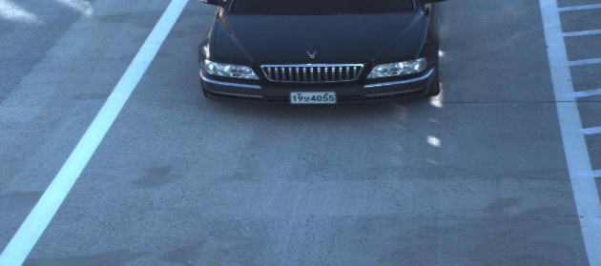
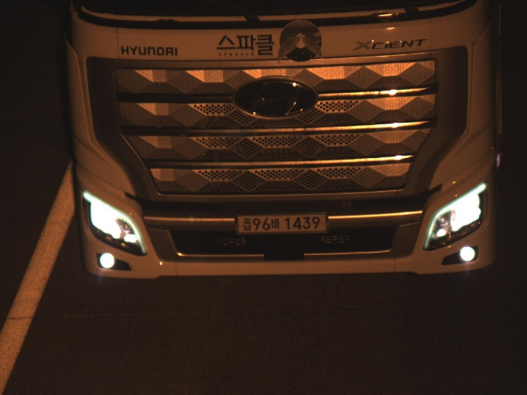
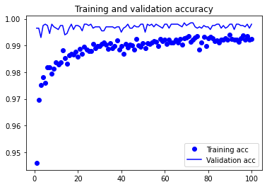
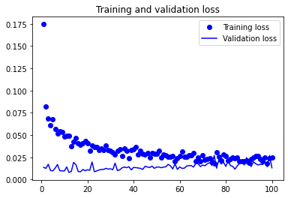
시험 방법 end
3차 시험
차량이 더 잘 보이는 영상으로 변경
중앙으로 가는 차량 제거 (반이상보이는 차량)
자동분류기로 분류 후 수작업으로 정정
서대구 영업소 다차로 50298장
Train 10000(소형 5000, 대형 5000)
Validation 2000(소형 1000, 대형 1000)
Test 3596(소형 1748, 대형 1748)
인식 인정 기준 80% 이상
인식 99.42%(21건) / 오인식 0.08% (3건)
epoch 100, batch = 20
accuracy
loss

Slide 64
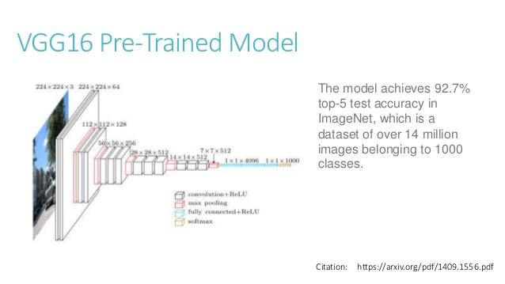
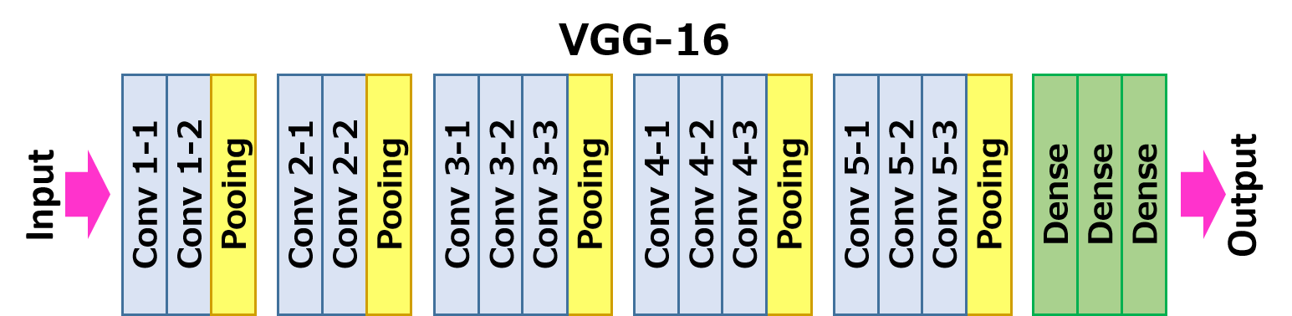
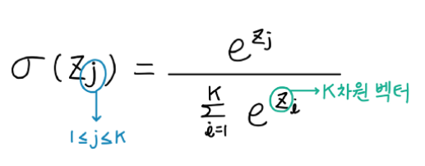
사용 모델 및 구현
시험 디렉토리 구조
Train 시작
./
datasets
디렉토리 생성
train
train 디렉토리
224x224 resize
0~1 정규화
train 디렉토리에서
카테고리 개수 파악
class16
train 영상갯수파악
validation 영상갯수 파악
class25
validation
유효검증 디렉토리
train 영상 증폭
ImageDataGenerator
class16
ImageDataGenerator
로 train, validation 영상 읽기
class25
test
test 디렉토리
Vgg16 cnn base 생성
result
Custom fc (full connected layer)
Drop out 50%, relu
class16
class25
Soft max 출력
모델저장
Log, weight 저장
No_categorie

Slide 65
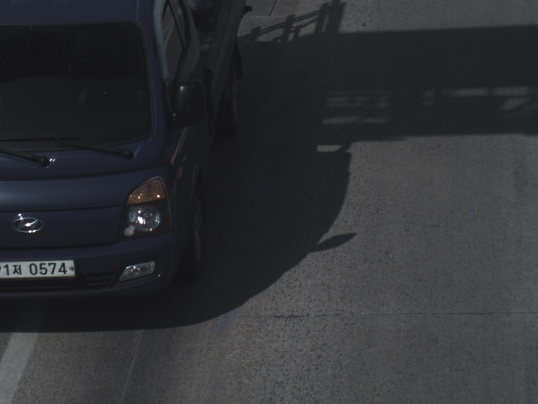
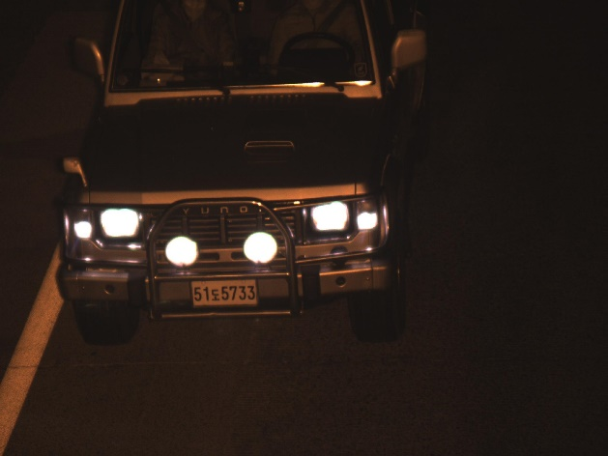
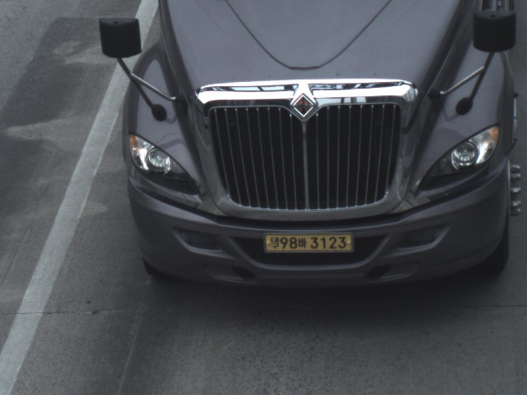
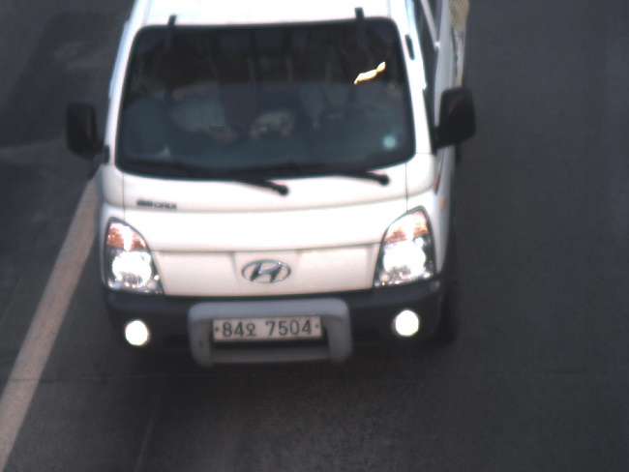
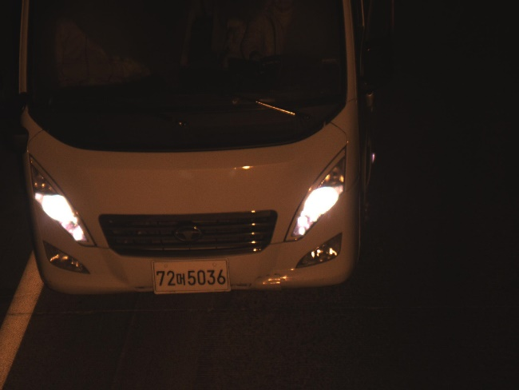
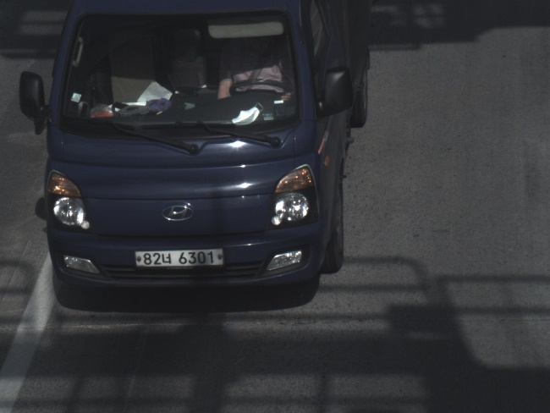
미인식 / 오인식 영상
오인식
소형->대형
대형->소형
미인식
영상만 봐서는 특별한 특이점은 없음

Slide 66
추후 과제
타차로 검증
Model / Weight
읽기
Open cv
C++ 제품화 dll
오인식/미인식 향상방안

Slide 67
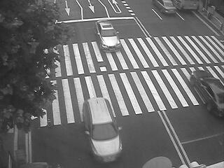
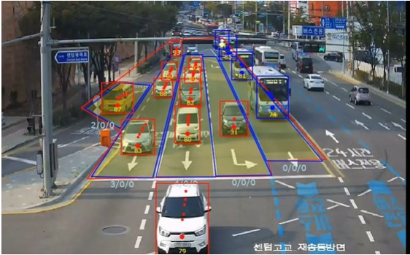
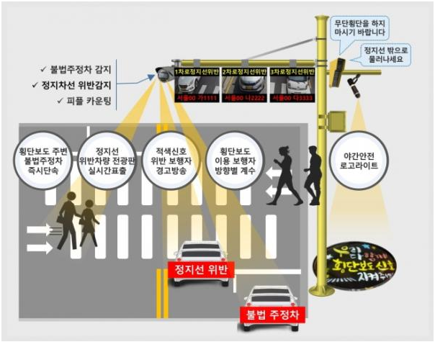
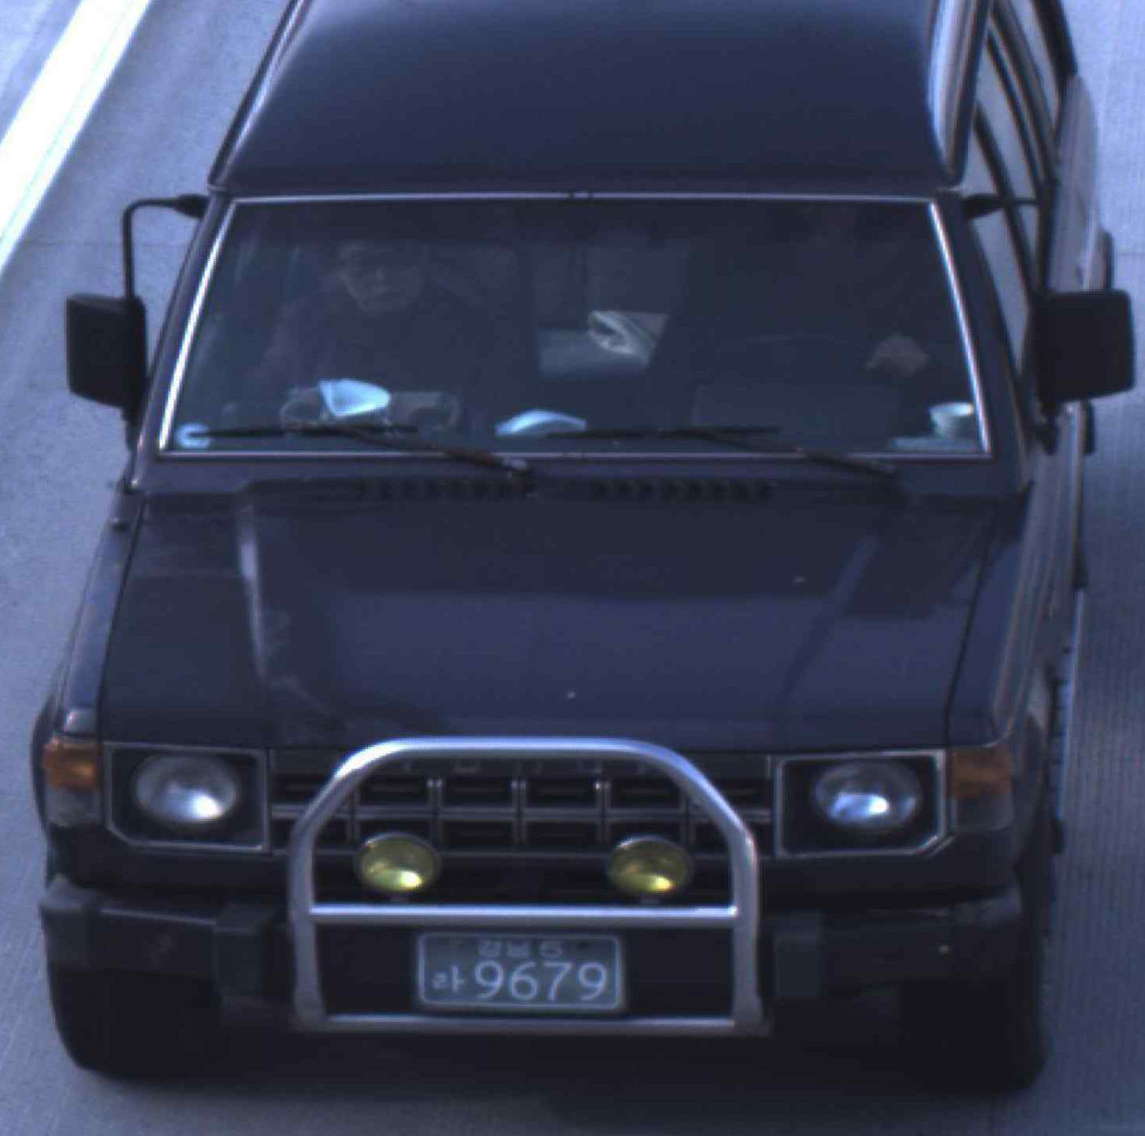
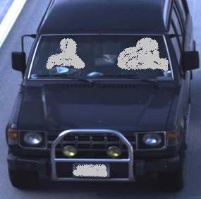
시스템 응용 분야
1) Object Detection
스마트 교차로
스마트교차로_2
2) Object Detection + Segmentation
어린이보호구역
개인정보삭제

Slide 68
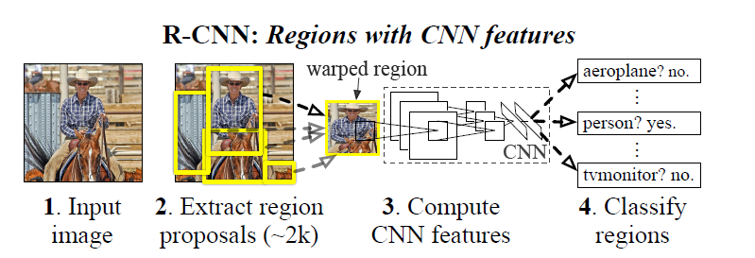
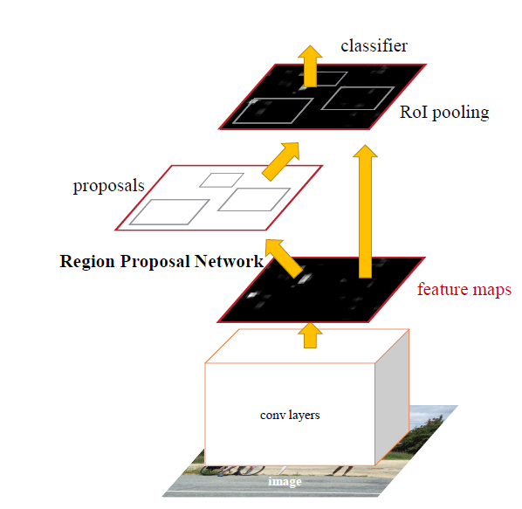
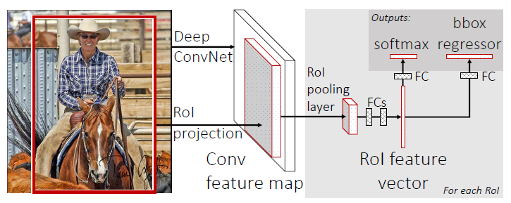
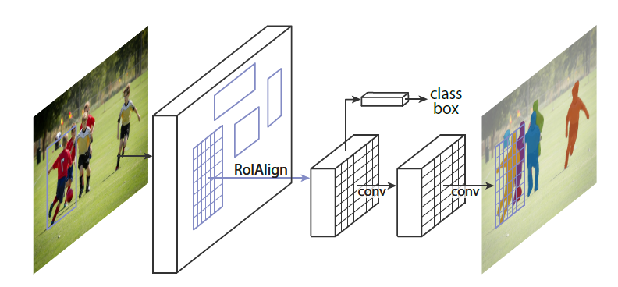
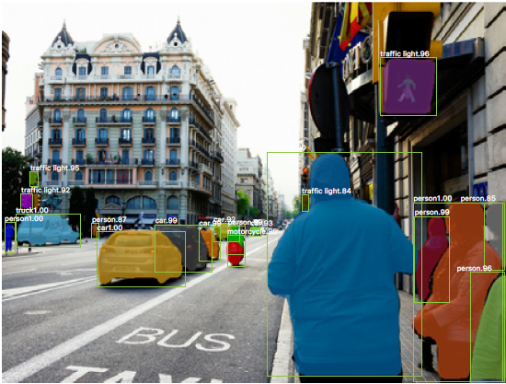
객체 검지 기술개발 방향
1
RCNN
3
FASTER RCNN
FAST RCNN
2
4
MASK RCNN

Slide 69
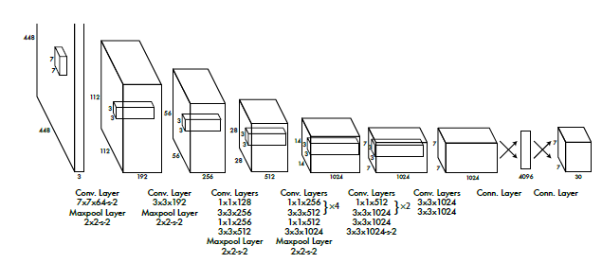
객체 검지 기술개발 방향
YOLO (You olnly look once)
5

Slide 70
2021년 영상제품 개발
2021년
2022년
2023년
Inpeg 리눅스 영상제품 내재화
도공/현장 기능개선 대응
도공 면탈/위찰 시운전 지원
다차로 영상제품 설치 시운전 지원
무인 조달 우수 지원?
차량 분류
현재 상황 및 필요 사항
Faster RCNN 소스 파악 완료
차로 영상 샘플 취득 / 시험
시험 위한 장비 / 인원 문제
객체검지?

